Slide 1
Data-Level Parallelism Architecture
09
Kai Bu
kaibu@zju.edu.cn
http://list.zju.edu.cn/kaibu/comparch2022

Slide 2
Data-Level Parallelism
Notes:
Since a multiple instruction multiple data (MIMD) architecture needs to fetch one instruction per data operation, single instruction multiple data (SIMD) is potentially more energy-efficient since a single instruction can launch many data operations.
Finally, perhaps the biggest advantage of SIMD versus MIMD is that the programmer continues to think sequentially yet achieves parallel speedup by having parallel data operations.

Slide 3
Data-Level Parallelism
exploit parallelism from simultaneous
operations across large sets of data rather
than from multiple threads of control

Slide 4
Data-Level Parallelism
potentially more energy-efficient:
a single instruction can launch
many data operations
Notes:
Since a multiple instruction multiple data (MIMD) architecture needs to fetch one instruction per data operation, single instruction multiple data (SIMD) is potentially more energy-efficient since a single instruction can launch many data operations.

Slide 5
Data-Level Parallelism
easier on the programmer than
classic parallel MIMD programming
Notes:
Finally, perhaps the biggest advantage of SIMD versus MIMD is that the programmer continues to think sequentially yet achieves parallel speedup by having parallel data operations.
For problems with lots of data parallelism, all three SIMD variations share the advantage of being easier on the programmer than classic parallel MIMD programming.

Slide 6
Data-Level Parallelism
example applications:
matrix-oriented scientific computing
media-oriented image & sound processing
machine learning

Slide 7
Data-Level Parallelism
example architectures:
Vector Architecture
Multimedia SIMD
GPU
Vector Architecture
Notes:
GPU: graphics processing unit

Slide 8
Vector Architecture
Grab sets of data elements scattered about memory
Place them in large sequential reg files
Operate on data in those reg files
Disperse the results back into memory

Slide 9
Vector Architecture
Grab sets of data elements scattered about memory
Place them in large sequential reg files
Operate on data in those reg files
Disperse the results back into memory
A single instruction works on vector of data, which results in dozens of register-register operations on independent data elements

Slide 10
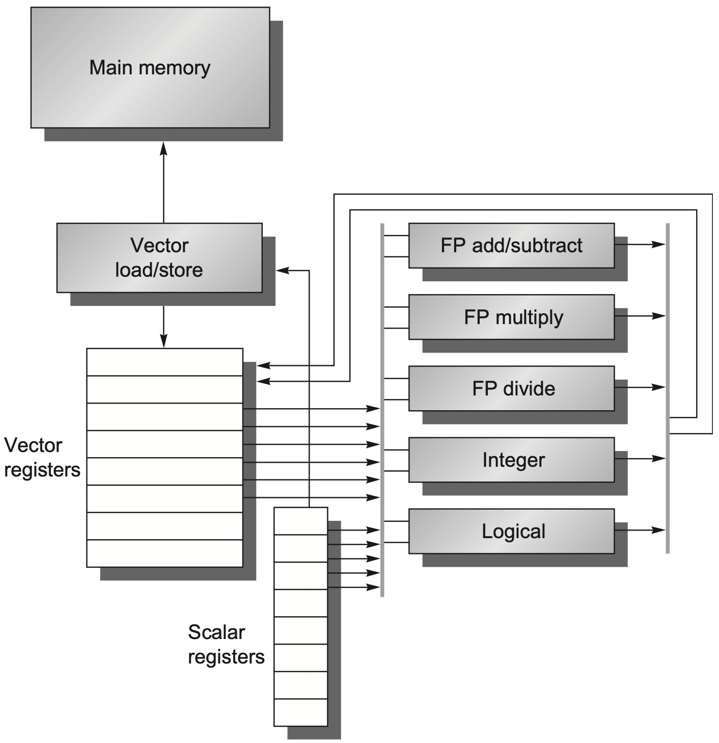
RV64V
Notes:
Figure 4.1 The basic structure of a vector architecture, RV64V, which includes a RISC-V scalar architecture. There are also 32 vector registers, and all the functional units are vector functional units. The vector and scalar registers have a significant number of read and write ports to allow multiple simultaneous vector operations. A set of crossbar switches (thick gray lines) connects these ports to the inputs and outputs of the vector functional units.
We begin with a vector processor consisting of the primary components that Figure 4.1 shows. It is loosely based on the 40-year-old Cray-1, which was one of the first supercomputers. At the time of the writing of this edition, the RISC- V vector instruction set extension RVV was still under development. (The vector extension by itself is called RVV, so RV64V refers to the RISC-V base instructions plus the vector extension.)

Slide 11
RV64V
::32 vector registers;
::each is 64-bit wide and
holds a single vector;
::at least 16 read ports
and 8 write ports
connected to
vector functional units
by a pair of crossbar switches;
Notes:
The primary components of the instruction set architecture of RV64V are the following:
Vector registers—Each vector register holds a single vector, and RV64V has 32 of them, each 64 bits wide. The vector register file needs to provide enough ports to feed all the vector functional units. These ports will allow a high degree of overlap among vector operations to different vector registers. The read and write ports, which total at least 16 read ports and 8 write ports, are connected to the functional unit inputs or outputs by a pair of crossbar switches. One way to increase the register file bandwidth is to compose it from multiple banks, which work well with relatively long vectors.

Slide 12
RV64V
::each unit is
fully pipelined;
::start a new operation
on every clock cycle;
::control unit is needed
to detect hazards;
Notes:
Vector functional units—Each unit is fully pipelined in our implementation, and it can start a new operation on every clock cycle. A control unit is needed to detect hazards, both structural hazards for functional units and data hazards on register accesses. Figure 4.1 shows that we assume an implementation of RV64V has five functional units. For simplicity, we focus on the floating-point functional units in this section.

Slide 13
RV64V
::each unit is
fully pipelined;
::start a new operation
on every clock cycle;
::control unit is needed
to detect hazards;
different from
scalar FP pipeline;
Notes:
Vector functional units—Each unit is fully pipelined in our implementation, and it can start a new operation on every clock cycle. A control unit is needed to detect hazards, both structural hazards for functional units and data hazards on register accesses. Figure 4.1 shows that we assume an implementation of RV64V has five functional units. For simplicity, we focus on the floating-point functional units in this section.

Slide 14
RV64V
::load or store a vector
from or to memory
in a fully pipelined way;
::also handle scalar
loads and stores;
Notes:
Vector load/store unit—The vector memory unit loads or stores a vector to or from memory. The vector loads and stores are fully pipelined in our hypothetical RV64V implementation so that words can be moved between the vector registers and memory with a bandwidth of one word per clock cycle, after an initial latency. This unit would also normally handle scalar loads and stores.

Slide 15
RV64V
::31 general-purpose regs
and 32 FP regs;
::provide data as input
to vector functional units;
::compute addresses to
pass to vector load/store unit;
Notes:
A set of scalar registers—Scalar registers can likewise provide data as input to the vector functional units, as well as compute addresses to pass to the vector load/store unit. These are the normal 31 general-purpose registers and 32 floating-point registers of RV64G. One input of the vector functional units latches scalar values as they are read out of the scalar register file.

Slide 16
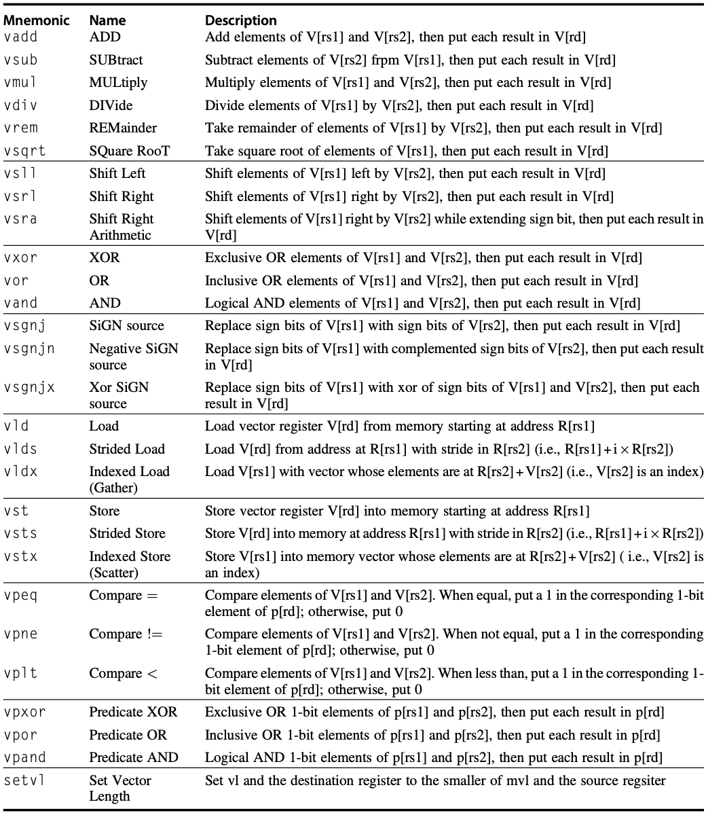
RV64V
Vector
Instructions
Notes:
Figure4.2 TheRV64Vvectorinstructions.AllusetheRinstructionformat.Eachvectoroperationwithtwooperands is shown with both operands being vector (.vv), but there are also versions where the second operand is a scalar register (.vs) and, when it makes a difference, where the first operand is a scalar register and the second is a vector register (.sv). The type and width of the operands are determined by configuring each vector register rather than being supplied by the instruction. In addition to the vector registers and predicate registers, there are two vector control and status registers (CSRs), vl and vctype, discussed below. The strided and indexed data transfers are also explained later. Once completed, RV64 will surely have more instructions, but the ones in this figure will be included.

Slide 17
RV64V
Vector
Instructions
::all use R format;
::suffix .vv for instructions
with both operands being vectors,
.vs for vector and scalar,
.sv for scalar and vector;
commutative operations have
only the first two versions;
Notes:
Figure 4.2 The RV64V vectorin structions. All use the R instruction format. Each vector operation with two operands is shown with both operands being vector (.vv), but there are also versions where the second operand is a scalar register (.vs) and, when it makes a difference, where the first operand is a scalar register and the second is a vector register (.sv). The type and width of the operands are determined by configuring each vector register rather than being supplied by the instruction. In addition to the vector registers and predicate registers, there are two vector control and status registers (CSRs), vl and vctype, discussed below. The strided and indexed data transfers are also explained later. Once completed, RV64 will surely have more instructions, but the ones in this figure will be included.
Add and other commutative operations have only the first two versions, as vadd.vs and vadd.sv would be redundant.

Slide 18
RV64V
Vector
Instructions
data type and size?
Notes:
To be discussed in next slide

Slide 19
Dynamic Register Typing
Omitted in instruction encoding
Associated a data type and data size with each vector register
Notes:
The type and width of the operands are determined by configuring each vector register rather than being supplied by the instruction.

Slide 20
Dynamic Register Typing
Omitted in instruction encoding
Associated a data type and data size with each vector register
Before executing vector instructions, program configures the vector registers being used to specify their data type and widths: Integer: 8, 16, 32, and 64 bits Floating point: 16, 32, and 64 bits
Notes:
Figure 4.3 Data sizes supported for RV64V assuming it also has the single- and double-precision floating-point extensions RVS and RVD. Adding RVV to such a RISC-V design means the scalar unit must also add RVH, which is a scalar instruction extension to support half-precision (16-bit) IEEE 754 floating point. Because RV32V would not have doubleword scalar operations, it could drop 64-bit integers from the vector unit. If a RISC-V implementation didn’t include RVS or RVD, it could omit the vec- tor floating-point instructions.

Slide 21
Dynamic Register Typing
Limit the number of instructions (without using combinations of data types and sizes in instruction encoding)
Notes:
One reason for dynamic register typing is that many instructions are required for a conventional vector architecture that supports such variety. Given the com- binations of data types and sizes in Figure 4.3, if not for dynamic register typing, Figure 4.2 would be several pages long!

Slide 22
Dynamic Register Typing
Limit the number of instructions
Enable programs to disable unused vector registers example: 1024-byte vector memory, 4 vector registers are enabled, then allocate 1024/4 = 256 bytes for each vector register (mvl: maximum vector length)
Notes:
Dynamic typing also lets programs disable unused vector registers. As a conse- quence, enabled vector registers are allocated all the vector memory as long vectors. For example, assume we have 1024 bytes of vector memory, if 4 vector registers are enabled and they are type 64–bit floats, the processor would give each vector register 256 bytes or 256/81⁄432 elements. This valiue is called the maximum vector length (mvl), which is set by the processor and cannot be changed by sofware.
One complaint about vector architectures is that their larger state means slower context switch time. Our implementation of RV64V increases state a factor of 3: from 2!32!81⁄4512 bytes to 2!32!10241⁄41536 bytes. A pleasant side effect of dynamic register typing is that the program can configure vector registers as dis- abled when they are not being used, so there is no need to save and restore them on a context switch.

Slide 23
Dynamic Register Typing
Limit the number of instructions
Enable programs to disable unused vector registers
Support implict conversions between different size operands depending on register configuration rather than additional explicit conversion instruction
Notes:
A third benefit of dynamic register typing is that conversions between different size operands can be implicit depending on the configuration of the registers rather than as additional explicit conversion instructions. We’ll see an example of this benefit in the next section.

Slide 24
how vector processor works?

Slide 25
DAXPY Example
Double precision a x X plus Y
X and Y have 32 elements
x5 and x6 hold the starting addresses of X and Y, respectively

Slide 26
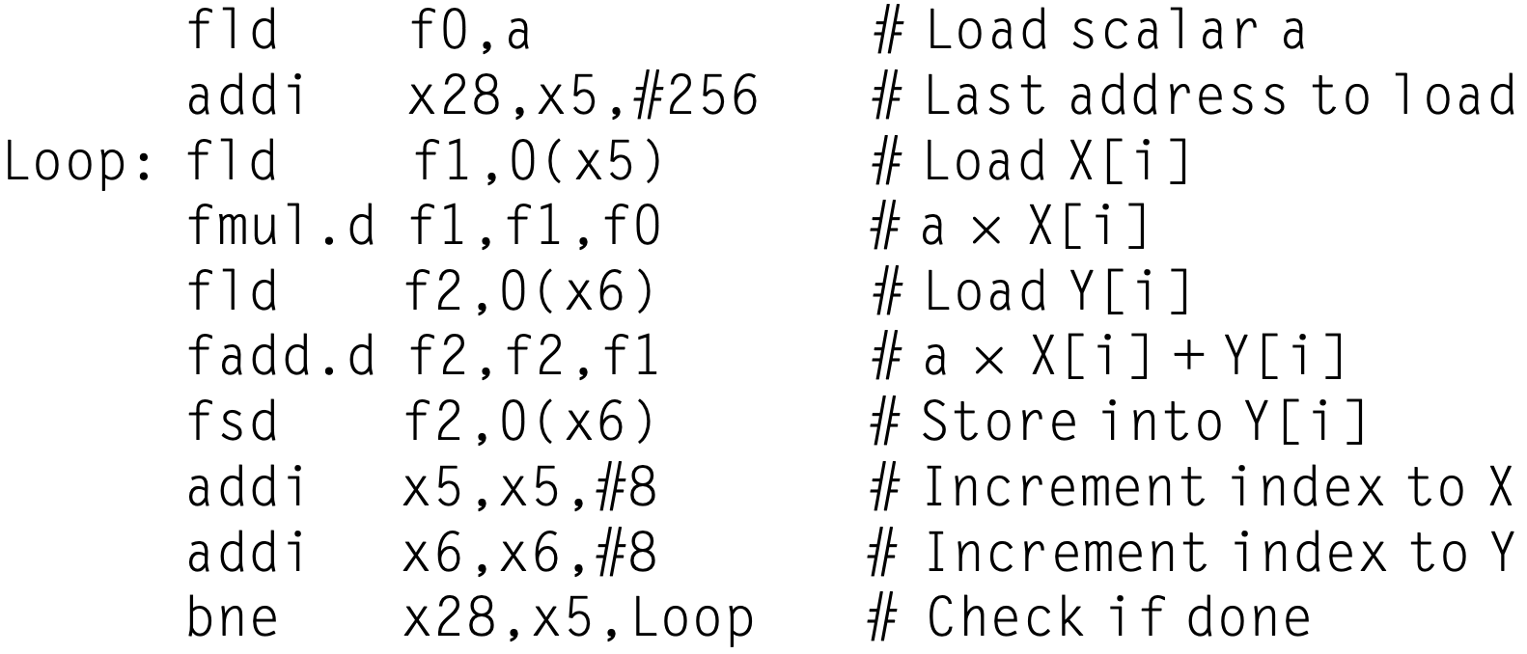
DAXPY Example
RISC-V code:

Slide 27
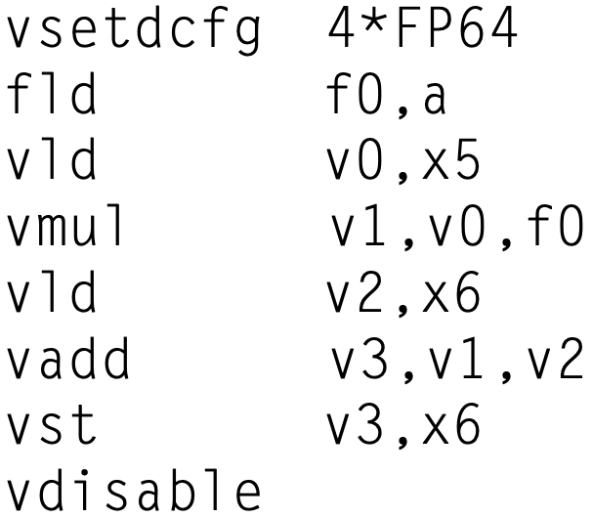
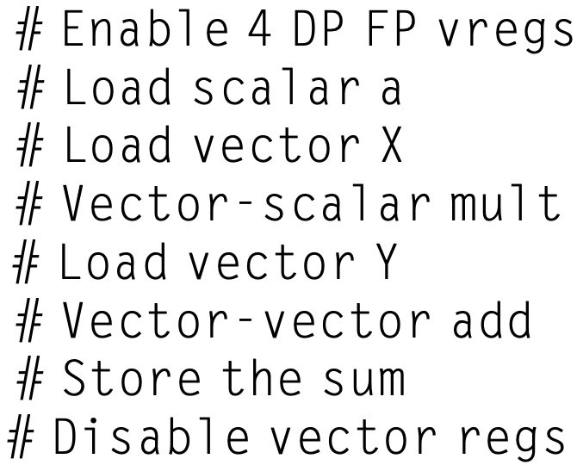
DAXPY Example
RV64V code:
no loop-carried dependences (dependences between iterations of a loop)
Notes:
The vsetdcfg instruction takes a scalar register value:
The vsetdcfg value specifies how many vector registers of each datatype are allocated, and is divided into a 2-bit mode field and pairs of 5-bit fields for each data type in the configuration.
https://inst.eecs.berkeley.edu/~cs152/sp19/handouts/sp19/riscv-spec-rvv-v0p4.pdf

Slide 28
DAXPY Example
RV64V code:
assembler determines version of vector operations, e.g., vmul.vs and vadd.vv
Notes:
Note that the assembler determines which version of the vector operations to gen- erate. Because the multiply has a scalar operand, it generates vmul.vs, whereas the add doesn’t, so it generates vadd.vv.

Slide 29
DAXPY Example
RV64V code:
each vector instruction stalls only for the first element in each vector

Slide 30
DAXPY Example
RV64V code: double-precision
pipeline stalls are required only once per vector instruction, rather than once per vector element

Slide 31
DAXPY Example
RV64V code: double-precision
Chaining: forwarding of element-dependent operations, in that dependent operations are chained together
Notes:
https://en.wikipedia.org/wiki/Chaining_(vector_processing)
In computing, chaining is a technique used in computer architecture in which scalar and vector registers generate interim results which can be used immediately, without additional memory references which reduce computational speed.
chaining allows them to be in the same convoy since it allows a vector operation to start as soon as the individual elements of its vector source operand become available: the results from the first functional unit in the chain are “forwarded” to the second functional unit.
In practice, we often imple- ment chaining by allowing the processor to read and write a particular vector reg- ister at the same time, albeit to different elements.

Slide 32
DAXPY Example
RV64V code: double-precision
Chaining: scalar and vector registers generate interim results which can be used immediately, without additional memory references
Notes:
https://en.wikipedia.org/wiki/Chaining_(vector_processing)
In computing, chaining is a technique used in computer architecture in which scalar and vector registers generate interim results which can be used immediately, without additional memory references which reduce computational speed.

Slide 33
DAXPY Example
RV64V code: double-precision
Flexible Chaining: allow a vector instruction to chain to essentially any other active vector instruction
Notes:
It might seem that in addition to vector instruction sequences with structural hazards, sequences with read-after-write dependency hazards should also be in separate convoys. However, chaining allows them to be in the same convoy since it allows a vector operation to start as soon as the individual elements of its vector source operand become available: the results from the first functional unit in the chain are “forwarded” to the second functional unit. In practice, we often imple- ment chaining by allowing the processor to read and write a particular vector reg- ister at the same time, albeit to different elements. Early implementations of chaining worked just like forwarding in scalar pipelining, but this restricted the timing of the source and destination instructions in the chain. Recent implementa- tions use flexible chaining, which allows a vector instruction to chain to essentially any other active vector instruction, assuming that we don’t generate a structural hazard.

Slide 34
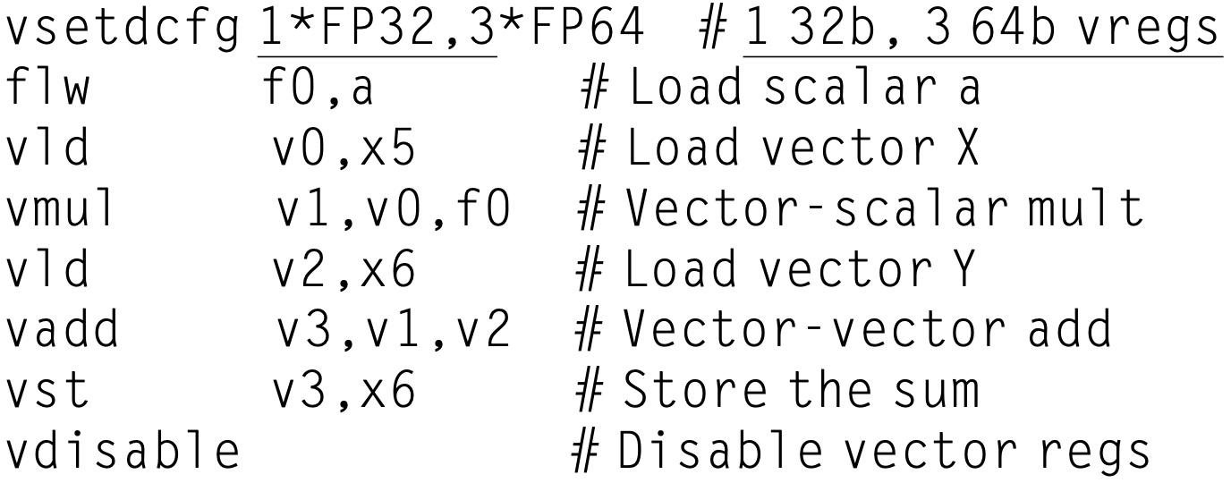
DAXPY Example
RV64V code: single-precision X and a
Notes:
?? Why 3 DP vregs
Y – double precision, then Load Y, ADD Y → v2, v3 need be DP
Why is a x X → V1 DP vreg?
::
to cope with potential sp x sp → dp

Slide 35
Vector Execution Time
For a sequence of vector operations: length of operand vectors? structual hazards among operations? data hazards?
Notes:
The execution time of a sequence of vector operations primarily depends on three factors: (1) the length of the operand vectors, (2) structural hazards among the operations, and (3) the data dependences.

Slide 36
Vector Execution Time
For a single vector instruction: vector length? initiation rate? (the rate at which a vector unit consumes new operands and produces new results)
Notes:
Given the vector length and the initiation rate, which is the rate at which a vector unit consumes new operands and produces new results, we can compute the time for a single vector instruction.

Slide 37
Vector Execution Time
Convoy: the set of vector instructions that could potentiallay execute together; co-convoy instructions must not contain any structural hazards; RAW is allowed in the same convoy;
Chime: the unit of time taken to execute the convoy
Notes:
chaining allows instruction sequences with read-after-write dependency hazards to be in the same convoy since it allows a vector operation to start as soon as the individual elements of its vector source operand become available: the results from the first functional unit in the chain are “forwarded” to the second functional unit. In practice, we often implement chaining by allowing the processor to read and write a particular vector register at the same time, albeit to different elements.

Slide 38
Vector Execution Time
Convoy: the set of vector instructions that could potentiallay execute together; co-convoy instructions must not contain any structural hazards; RAW is allowed in the same convoy;
Chime: the unit of time taken to execute the convoy
Cross-convoy instructions are serialized

Slide 39
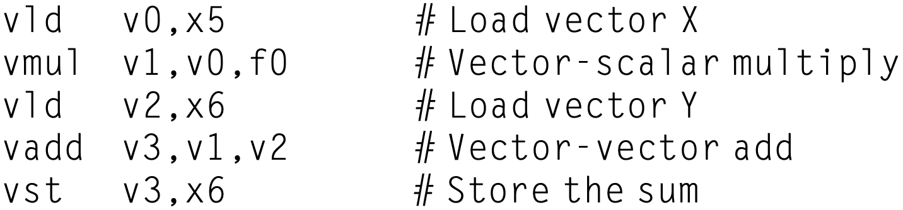
Vector Execution Time
Example code sequence:
Assume a single copy of each vector functional unit
How many convoys/chimes?
How many cycles per FLOP (floating-point operation)?

Slide 40

Vector Execution Time
Example code sequence:
How many convoys/chimes? structural hazards: vld/vld, vld/vst

Slide 41
Vector Execution Time
Example code sequence:
How many convoys/chimes?: 3 structural hazards: vld/vld, vld/vst convoy 1: vld, vmul (v0 dependence) convoy 2: vld, vadd (v2 dependence) convoy 3: vst

Slide 42
Vector Execution Time
Example code sequence:
How many cycles per FLOP? assume 32-element vectors; approximate 32 cycles per chime, 32 x 3 = 96 cycles for 3 chimes, 32 x 2 = 64 cycles for FLOPs [add,mul]
Notes:
The sequence requires three convoys. Because the sequence takes three chimes and there are two floating-point operations per result, the number of cycles per FLOP is 1.5 (ignoring any vector instruction issue overhead).

Slide 43
Vector Execution Time
Example code sequence:
How many cycles per FLOP?: 1.5 assume 32-element vectors; approximate 32 cycles per chime, 96 / 64 = 1.5 cycle per FLOP

Slide 44
Vector Execution Time
A vector sequence that consists of m convoys executes in m chimes
For a vector length of n, this sequence takes approximately m x n clock cycles
Ignore processor-specific overheads such as vector instruction issue overhead and vector start-up time (i.e., latency until the pipeline is full)

Slide 45
how to optimize vector arch?

Slide 46
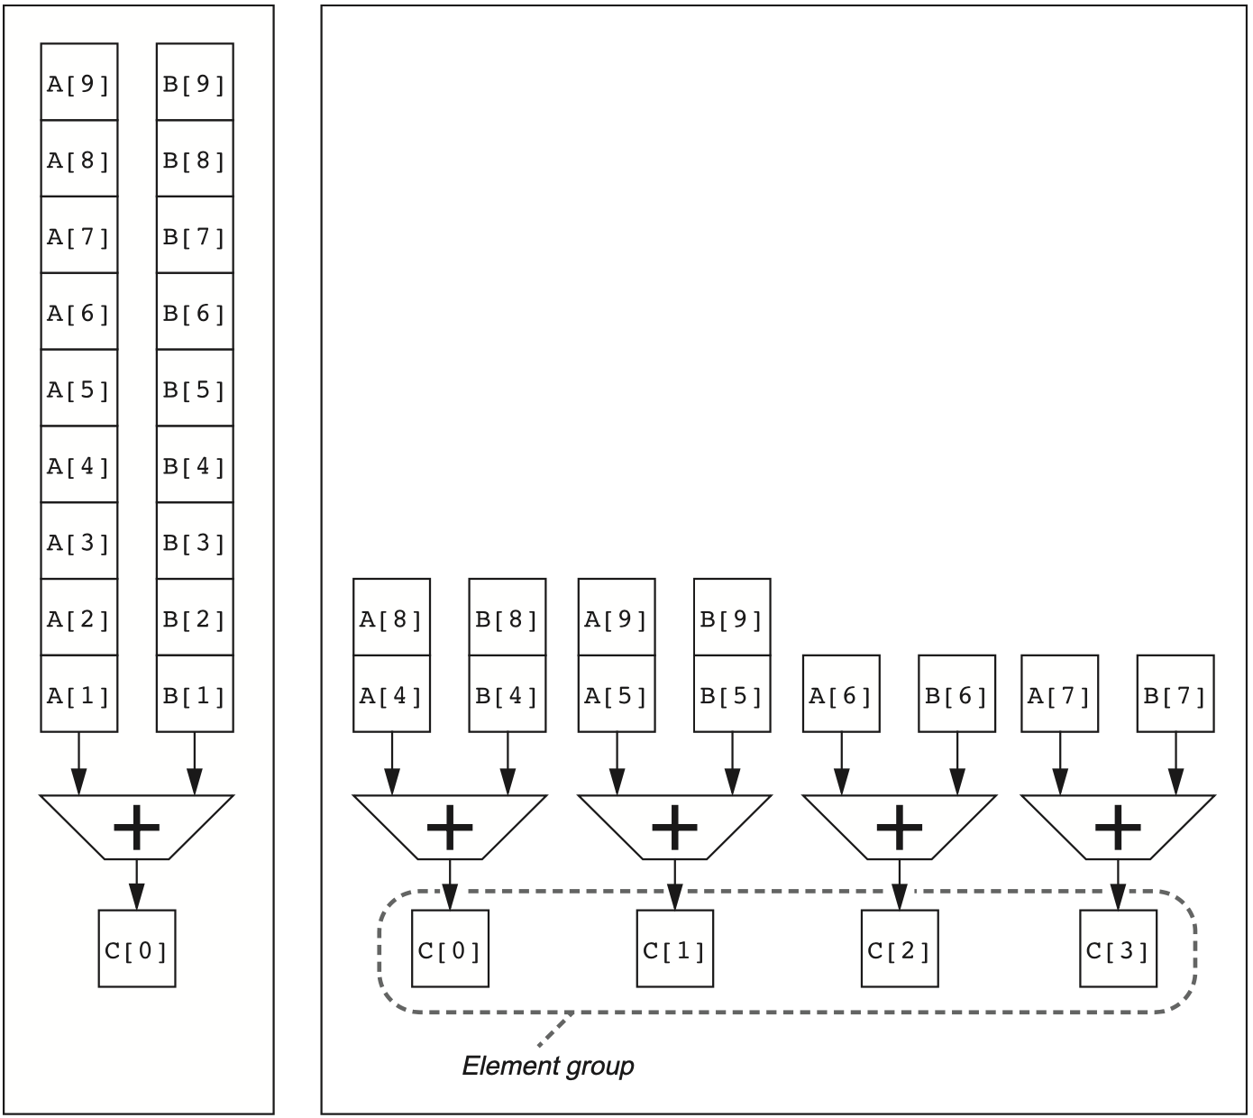
Multiple Lanes
use multiple functional units to improve vector performance;
process several elements per clock cycle;
Notes:
Figure 4.4 Using multiple functional units to improve the performance of a single vector add instruction, C5A+B. The vector processor (A) on the left has a single add pipeline and can complete one addition per clock cycle. The vector processor (B) on the right has four add pipelines and can complete four additions per clock cycle. The elements within a single vector add instruction are interleaved across the four pipelines. The set of elements that move through the pipelines together is termed an element group. Reproduced with permission from Asanovic, K., 1998. Vector Microprocessors (Ph.D. thesis). Computer Science Division, University of California, Berkeley.

Slide 47
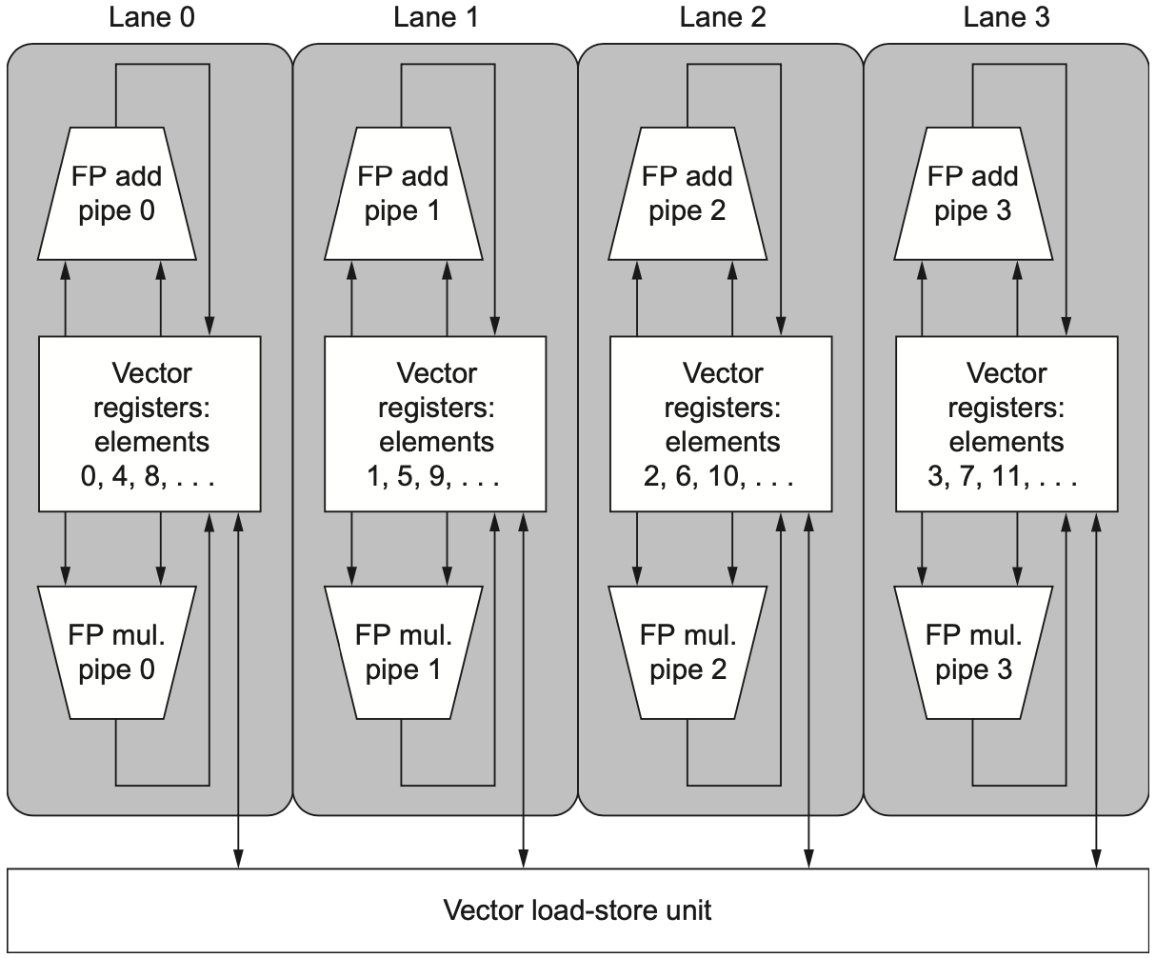
Multiple Lanes
Notes:
Figure 4.5 Structure of a vector unit containing four lanes. The vector register mem- ory is divided across the lanes, with each lane holding every fourth element of each vector register. The figure shows three vector functional units: an FP add, an FP multiply, and a load-store unit. Each of the vector arithmetic units contains four execution pipe- lines, one per lane, which act in concert to complete a single vector instruction. Note how [that?] each section of the vector register file needs to provide only enough ports for pipe- lines local to its lane. This figure does not show the path to provide the scalar operand for vector-scalar instructions, but the scalar processor (or Control Processor) broadcasts a scalar value to all lanes.

Slide 48
Multiple Lanes
vector register memory is divided across the lanes
Notes:
Figure 4.5 Structure of a vector unit containing four lanes. The vector register mem- ory is divided across the lanes, with each lane holding every fourth element of each vector register. The figure shows three vector functional units: an FP add, an FP multiply, and a load-store unit. Each of the vector arithmetic units contains four execution pipe- lines, one per lane, which act in concert to complete a single vector instruction. Note how [that?] each section of the vector register file needs to provide only enough ports for pipe- lines local to its lane. This figure does not show the path to provide the scalar operand for vector-scalar instructions, but the scalar processor (or Control Processor) broadcasts a scalar value to all lanes.

Slide 49
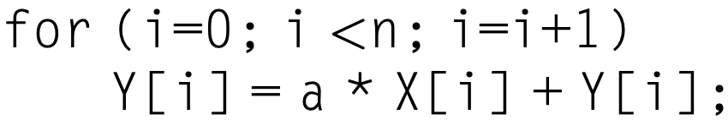
Vector-Length Registers
Vector length is often unknown at compile time
A single piece of code may require different vector lengths: n
Notes:
A vector register processor has a natural vector length determined by the maximum vector length (mvl). This length, which was 32 in our example above, is unlikely to match the real vector length in a program. Moreover, in a real program, the length of a particular vector operation is often unknown at compile time.
In fact, a single piece of code may require different vector lengths.
For example, consider this code:
for (i=0; i <n; i=i+1) Y[i] = a * X[i] + Y[i];
The size of all the vector operations depends on n, which may not even be known until run time. The value of n might also be a parameter to a procedure containing the preceding loop and therefore subject to change during execution.

Slide 50
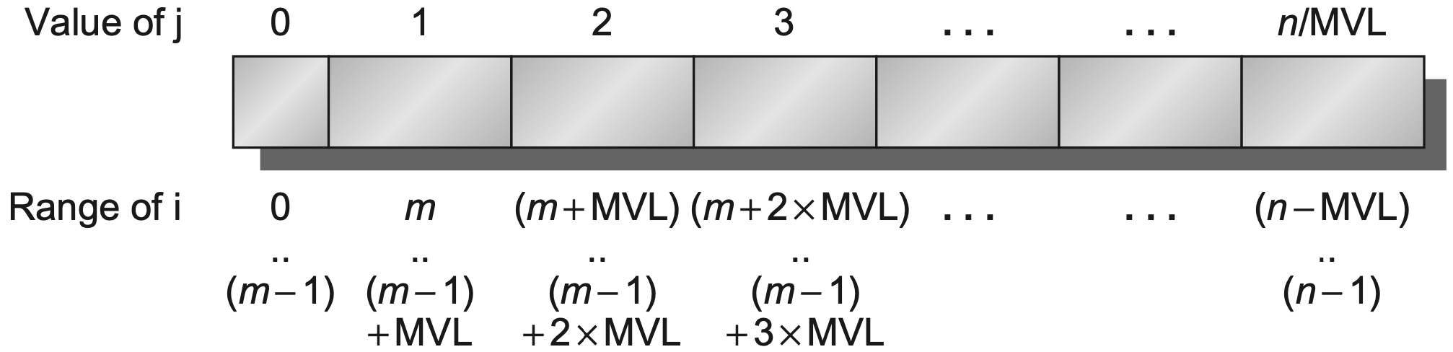
Vector-Length Registers
Vector-length register (vl) controls the length of any vector operation, including a vector load or store
The value in vl cannot be greater than the maximum vector length (mvl)
Notes:
The solution to these problems is to add a vector-length register (vl). The vl controls the length of any vector operation, including a vector load or store. The value in the vl, however, cannot be greater than the maximum vector length (mvl). This solves our problem as long as the real length is less than or equal to the max- imum vector length (mvl). This parameter means the length of vector registers can grow in later computer generations without changing the instruction set. As we will see in the next section, multimedia SIMD extensions have no equivalent of mvl, so they expand the instruction set every time they increase their vector length.

Slide 51
Vector-Length Registers
Strip mining generate code such that each vector operation is done for a size <= mvl: one loop handles any number of iterations that is a multiple of mvl, and another loop that handles any remaining iterations and must be less than mvl;
RISC-V instruction: setvl vl ← min(mvl, n); n is loop variable
Notes:
What if the value of n is not known at compile time and thus may be greater than the mvl? To tackle the second problem where the vector is longer than the maximum length, a technique called strip mining is traditionally used. Strip mining is the generation of code such that each vector operation is done for a size less than or equal to the mvl. One loop handles any number of iterations that is a multiple of the mvl and another loop that handles any remaining iterations and must be less than the mvl.

Slide 52
Vector-Length Registers
RV64V code for vector DAXPY of any n

Slide 53
Vector-Length Registers
a0 initialized as vector size n;
RV64V code for vector DAXPY of any n

Slide 54
Vector-Length Registers
DP = 64 bits = 8 bytes per element;
x5/x6 to track starting addresses of next vector segments;
RV64V code for vector DAXPY of any n

Slide 55
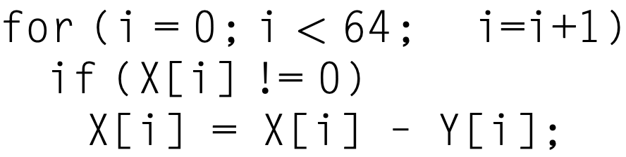
how to handle IF in loops?

Slide 56
how to handle IF in loops?
do not operate on elements if X[i] != 0

Slide 57
Predicate Registers
Vector-mask control use predicate registers to hold the mask and essentially provide conditional execution of each element operation
When the predicate register p0 is set, all following vector instructions operate only on the vector elements whose corresponding entries in the predicate register is 1

Slide 58
Predicate Registers
Vector-mask control
When the predicate register p0 is set, all following vector instructions operate only on the vector elements whose corresponding entries in the predicate register is 1
The entries in the destination vector register that correspond to 0 in the mask register are unaffected by the vector operation

Slide 59
Predicate Registers
Vector-mask control
When the predicate register p0 is set, all following vector instructions operate only on the vector elements whose corresponding entries in the predicate register is 1
Enabling a predicate register initializes it to all 1s, meaning that subsequent vector instructions operate on all vector elements

Slide 60
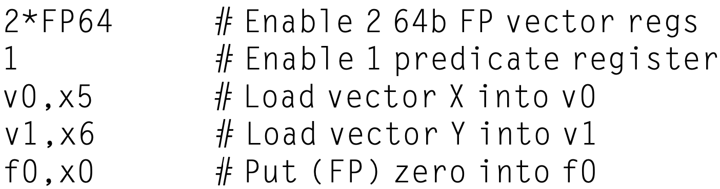
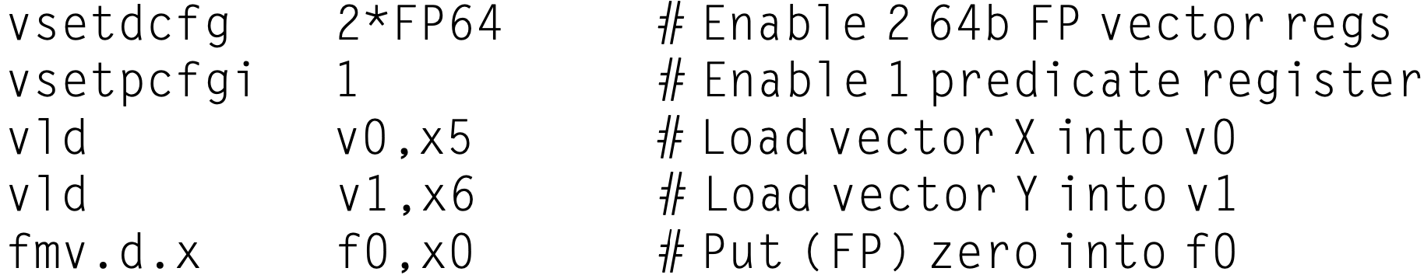
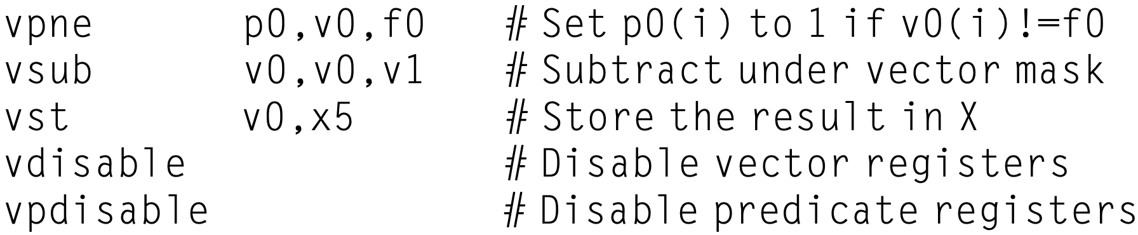
Predicate Registers
Example

Slide 61
Predicate Registers
Example
IF-conversion: for compiler writers to transform IF-stats to straight-line code

Slide 62
Memory Banks
Support simultaneous accesses from multiple loads or stores (whose memory bank cycle time is usually several times larger than the processor cycle time)
Load or store data words that are not sequential
Share the same memory system by multiple processors
Notes:
Most vector processors use memory banks, which allow several independent
accesses rather than simple memory interleaving for three reasons:
Many vector computers support many loads or stores per clock cycle, and the memory bank cycle time is usually several times larger than the processor cycle time. To support simultaneous accesses from multiple loads or stores, the mem- ory system needs multiple banks and needs to be able to control the addresses to the banks independently.
Most vector processors support the ability to load or store data words that are not sequential. In such cases, independent bank addressing, rather than inter- leaving, is required.
Most vector computers support multiple processors sharing the same memory system, so each processor will be generating its own separate stream of addresses.

Slide 63
Memory Banks
Example Cray T90 with 32 processors, each with 4 loads and 2 stores per clock cycle; processor cycle time: 2.167 ns; SRAM cycle time: 15 ns;
Question minimum number of memory banks for all processors to run at the full memory bandwidth?

Slide 64
Memory Banks
Example Cray T90 with 32 processors, each with 4 loads and 2 stores per clock cycle; processor cycle time: 2.167 ns; SRAM cycle time: 15 ns;
Solution maximum number of memory references per cycle: (4+2) x 32 = 192; SRAM cycle: 15/2.167 = 6.92≈7 cycles; min number of banks: 192 x 7 = 1344;
Notes:
Each memory bank supports one access per 7 cycles;
In 7 cycles, processors already require/accumulate 192 x 7 = 1344 access requests,
So, need 1344 banks at minimum to support all requests from processors;

Slide 65
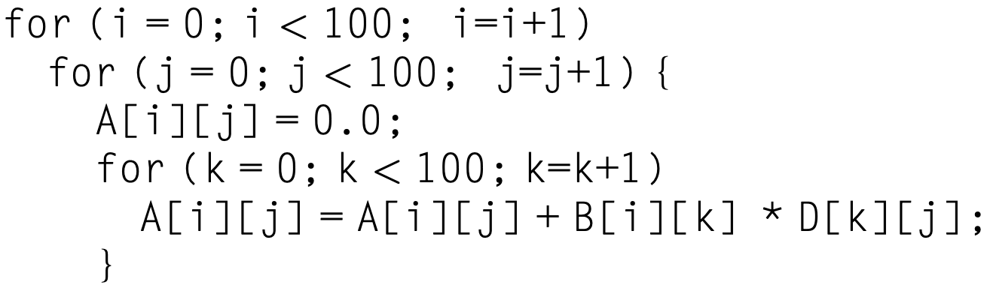
Stride
Memory positions of adjacent elements in a vector may not be sequential
Assume row-major order, accesses to D-elements are separated by the row size times 8 (# of bytes per entry)

Slide 66
Stride
Stride: the distance separating elements to be gathered into a single vector register
Unit stride stride of 1, for adjacent elements
Nonunit stride stride greater than 1, for separated elements

Slide 67
Stride
VLDS (load vector with stride) instruction for fetching a nonunit stride vector into a vector register
VSTS (store vector with stride) instruction for storing a nonunit stride vector into memory

Slide 68
Stride
Example 8 mem bank, 6-clock bank busy time, 12-cycle total memory latency
Question how long to complete a 64-element vector with a stride of 1? With a stride of 32?

Slide 69
Stride
Example 8 mem bank, 6-clock bank busy time, 12-cycle total memory latency
Solution total memory latency = memory access time + bank busy time; fully pipelined vector initiation rate = one word (element?) per clock cycle

Slide 70
Stride
Example 8 mem bank, 6-clock bank busy time, 12-cycle total memory latency
Solution for a stride of 1, as bank # > bank busy time, no stalls due to bank conflicts (i.e., an access request reaches an occupied bank)

Slide 71
Stride
Example 8 mem bank, 6-clock bank busy time, 12-cycle total memory latency
Solution for a stride of 1, as bank # > bank busy time, no stalls due to bank conflicts, after 12-cycle memory latency, one element per clock cycle: 12 + 64 = 76 clock cycles

Slide 72
Stride
Example 8 mem bank, 6-clock bank busy time, 12-cycle total memory latency
Solution for a stride of 32, as stride%bank = 0, every access request goes to bank 0 and causes a bank conflict and thus stall from the 2nd access: 12 + 1 + 6 x 63 = 391 clock cycles

Slide 73
Stride
A bank conflict and thus a stall occurs if:
Examples:
LCM(1, 8) / 1 = 8 ? bank busy time
LCM(32, 8) / 32 = 1 ? bank busy time
LCM(6, 16) / 6 = 8 ? bank busy time bank access: 0, 6, 12, 2, 8, 14, 4, 10,
0, 6, 12…
LCM(stride, number of banks)
< bank busy time
stride
Notes:
LCM: least common multiple
The least common multiple of two numbers is the smallest number that is a multiple of both of them.

Slide 74
Stride
A bank conflict and thus a stall occurs if:
Examples:
LCM(1, 8) / 1 = 8 ? bank busy time
LCM(32, 8) / 32 = 1 ? bank busy time
LCM(6, 16) / 6 = 8 ? bank busy time bank access: 0, 6, 12, 2, 8, 14, 4, 10,
0, 6, 12…
LCM(stride, number of banks)
< bank busy time
stride
8 cycles to hit the same bank
Notes:
https://www.es.ele.tue.nl/~heco/courses/ECA/DLP-architectures.pptx
LCM: least common multiple
The least common multiple of two numbers is the smallest number that is a multiple of both of them.

Slide 75

Gather-Scatter
Sparse matrices using index vectors
Sparse vector/arrays A and C
Index vectors K and M designate nonzero elements of A and C
A and C have the same number of nonzero elements

Slide 76
Gather-Scatter
Gather fetch the vector whose elements are at the addresses given by adding a base address to the offsets given in the index vector;
Scatter store and expand the dense vector results from the result vector registor to memory using the same index vector;

Slide 77
Gather-Scatter
vldx instruction to load vector indexed or gather
vstx instruction to store vector indexed or scatter

Slide 78
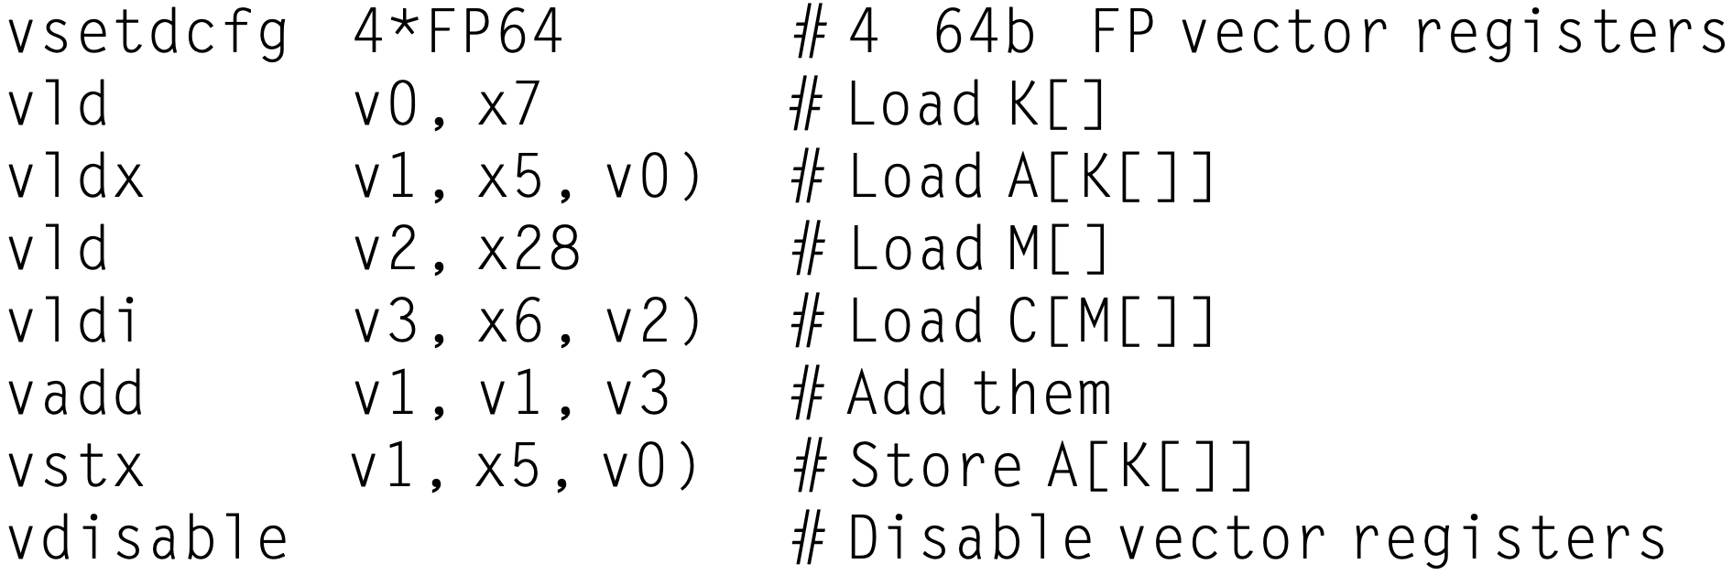

Gather-Scatter
Sparse matrices using index vectors
RV64V code
x5, x6: A, C
x7, x28: K, M
Notes:
Need not be A[i]+C[i]
Just add one nonzero element of A with one nonzero element of C;

Slide 79
how to vectorize program?

Slide 80
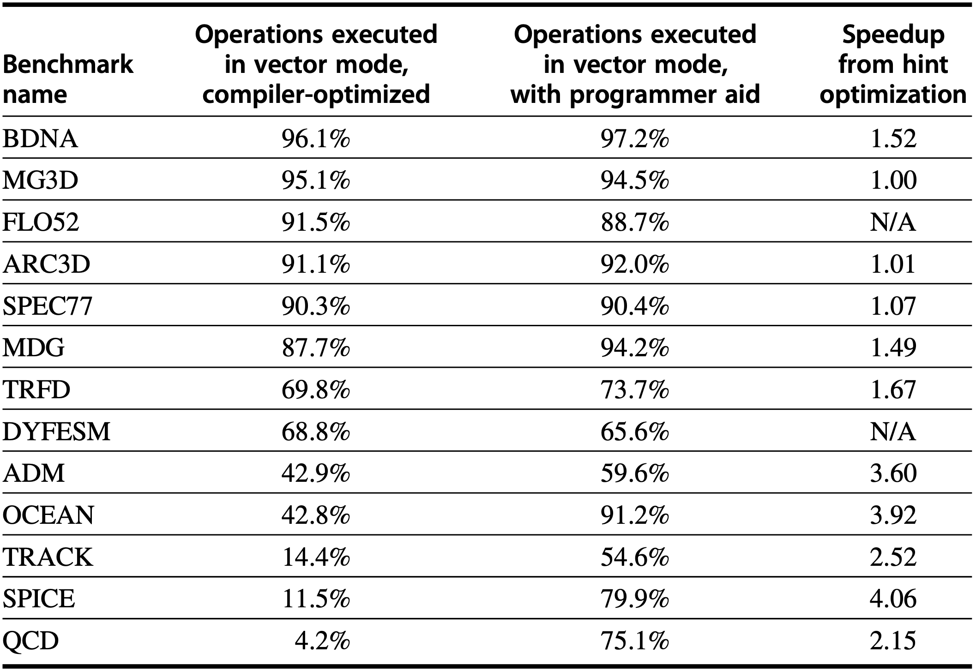
Programming Vector Arch
improve program using compiler hints to
vectorize more
Notes:
An advantage of vector architectures is that compilers can tell programmers at compile time whether a section of code will vectorize or not, often giving hints as to why it did not vectorize the code. This straightforward execution model allows experts in other domains to learn how to improve performance by revising their code or by giving hints to the compiler when it’s okay to assume independence between operations, such as for gather-scatter data transfers. It is this dialogue between the compiler and the programmer, with each side giving hints to the other on how to improve performance, that simplifies programming of vector computers.

Slide 81
Data-Level Parallelism
example architectures:
Vector Architecture
Multimedia SIMD
GPU
Vector Architecture
Multimedia SIMD
Notes:
GPU: graphics processing unit

Slide 82
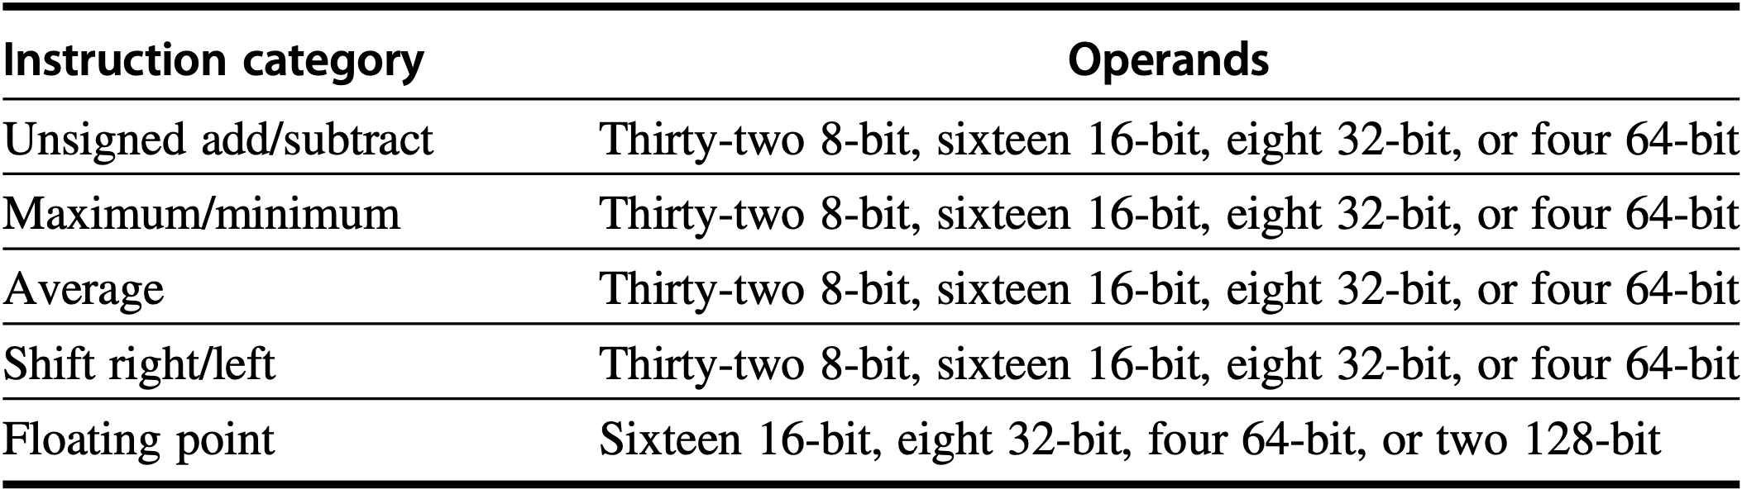
Multimedia SIMD
Suit for short, fixed-length vectors 256-bit-wide example operations:
Omissions: vector length register, strided or gather/scatter data transfer instructions, and mask registers

Slide 83
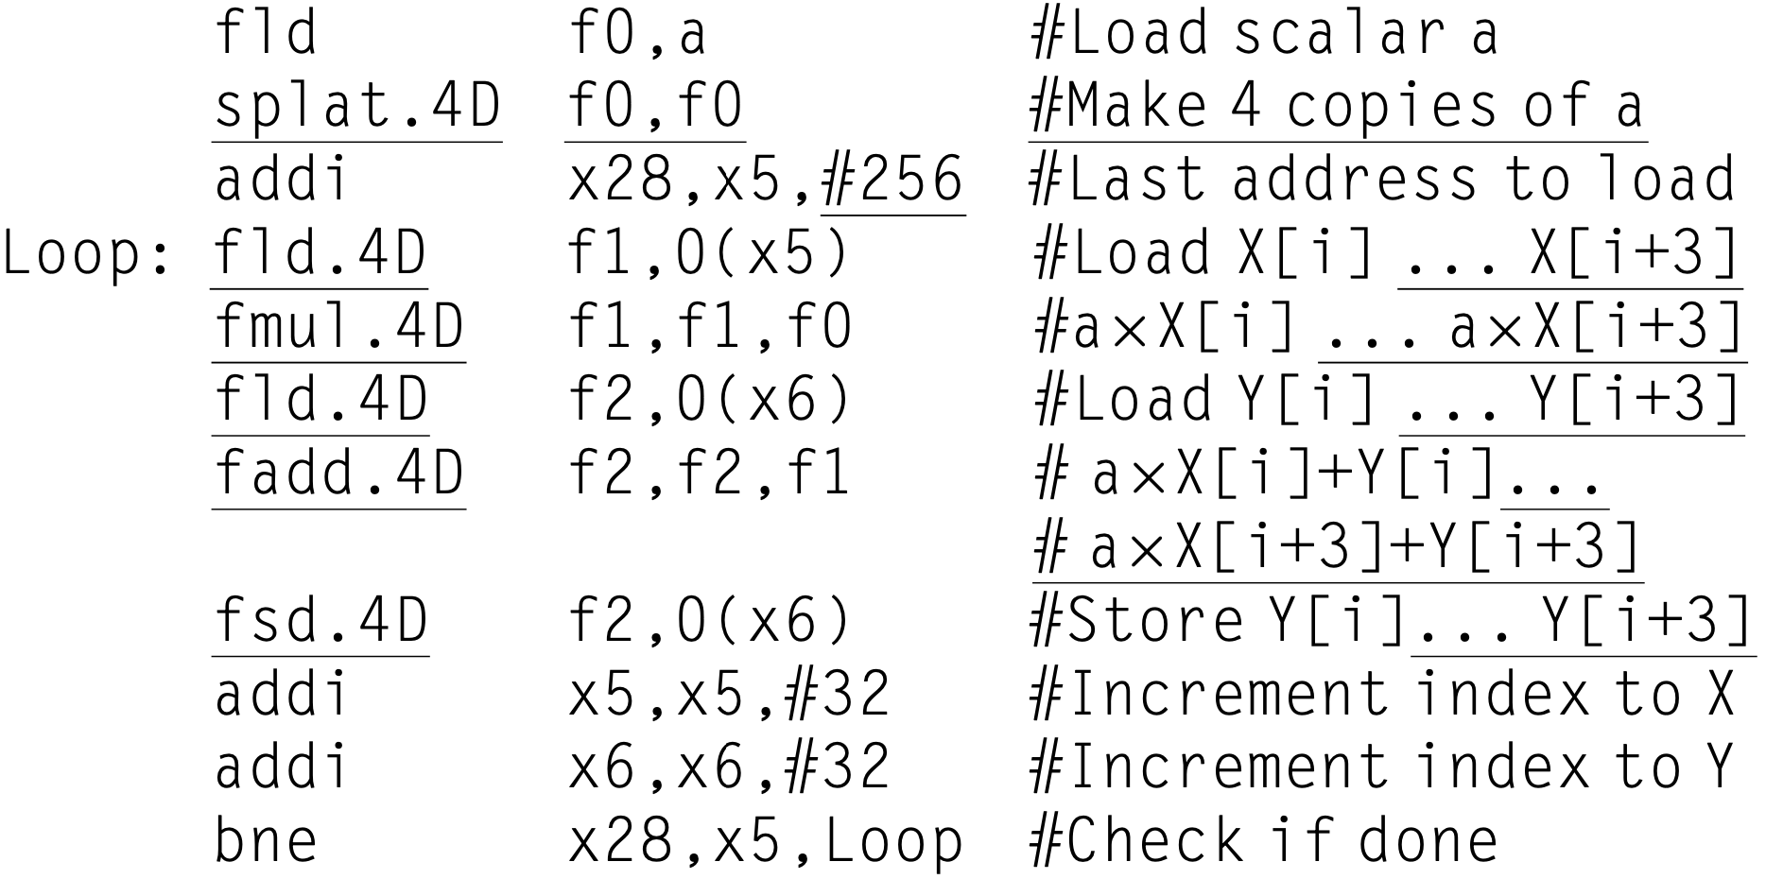
Multimedia SIMD
RISC-V SIMD code for DAXPY: 256-bit SIMD multimedia instruciton; .4D operates on 4 DP operarnds at once
Notes:
Both X and Y have 32 DP elements

Slide 84
Multimedia SIMD
Roofline Visual Performance Model correlate FP performance, memory performance, and arithmetic intensity in a two-dimensional graph
Arithmetic intensity ratio of FP operations per byte of memory accessed
Notes:
One visual, intuitive way to compare potential floating-point performance of var- iations of SIMD architectures is the Roofline model (Williams et al., 2009). The horizontal and diagonal lines of the graphs it produces give this simple model its name and indicate its value (see Figure 4.11). It ties together floating-point perfor- mance, memory performance, and arithmetic intensity in a two-dimensional graph.
Arithmetic intensity is the ratio of floating-point operations per byte of memory accessed. It can be calculated by taking the total number of floating-point opera- tions for a program divided by the total number of data bytes transferred to main memory during program execution.

Slide 85
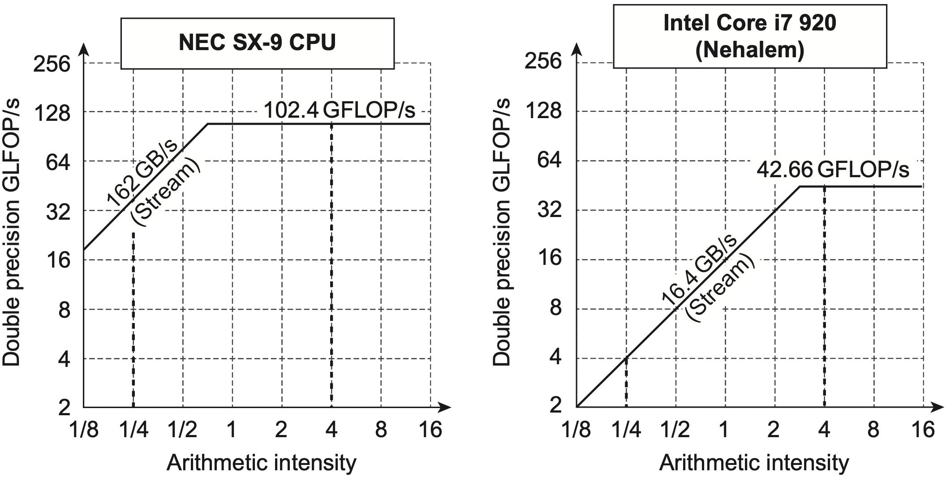
Multimedia SIMD
Stream benchmark for finding peak memory performance
GFLOP/s
GFLOP/s
GFLOP/s
GFLOP/s
Notes:
Figure 4.11 Roofline model for one NEC SX-9 vector processor on the left and the Intel Core i7 920 multicore computer with SIMD extensions on the right (Williams et al., 2009). This Roofline is for unit-stride memory accesses and double-precision floating-point performance. NEC SX-9 is a vector supercomputer announced in 2008 that cost millions of dollars. It has a peak DP FP performance of 102.4 GFLOP/s and a peak memory bandwidth of 162 GB/s from the Stream benchmark. The Core i7 920 has a peak DP FP performance of 42.66 GFLOP/s and a peak memory bandwidth of 16.4 GB/s. The dashed vertical lines at an arithmetic intensity of 4 FLOP/byte show that both processors operate at peak performance. In this case, the SX-9 at 102.4 FLOP/s is 2.4! faster than the Core i7 at 42.66GFLOP/s. At an arithmetic intensity of 0.25 FLOP/byte, the SX-9 is 10! faster at 40.5GFLOP/s versus 4.1 GFLOP/s for the Core i7.
Figure 4.11 shows the Roofline model for the NEC SX-9 vector processor on the left and the Intel Core i7 920 multicore computer on the right. The vertical Y- axis is achievable floating-point performance from 2 to 256 GFLOPS/s. The hor- izontal X-axis is arithmetic intensity, varying from 1/8 FLOP/DRAM byte accessed to 16 FLOP/DRAM byte accessed in both graphs. Note that the graph is a log-log scale, and that Rooflines are done just once for a computer.

Slide 86
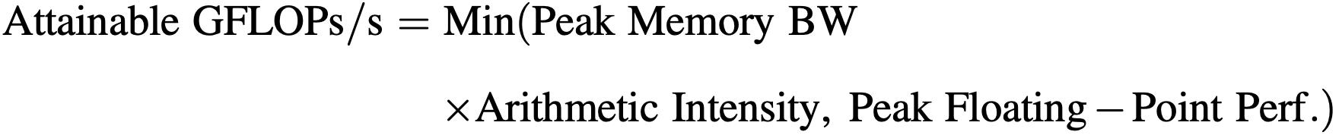
Multimedia SIMD
GFLOP/s
GFLOP/s
Notes:
The “Roofline” sets an upper bound on performance of a kernel depending on its arithmetic intensity. If we think of arithmetic intensity as a pole that hits the roof, either it hits the flat part of the roof, which means performance is computationally limited, or it hits the slanted part of the roof, which means performance is ulti- mately limited by memory bandwidth. In Figure 4.11, the vertical dashed line on the right (arithmetic intensity of 4) is an example of the former and the vertical dashed line on the left (arithmetic intensity of 1/4) is an example of the latter. Given a Roofline model of a computer, you can apply it repeatedly, because it doesn’t vary by kernel.
Note that the “ridge point,” where the diagonal and horizontal roofs meet, offers an interesting insight into a computer. If it is far to the right, then only kernels with very high arithmetic intensity can achieve the maximum performance of that computer. If it is far to the left, then almost any kernel can potentially hit the max- imum performance. As we will see, this vector processor has both much higher memory bandwidth and a ridge point far to the left as compared to other SIMD Processors.
Figure 4.11 shows that the peak computational performance of the SX-9 is 2.4 ! faster than Core i7, but the memory performance is 10 ! faster. For programs with an arithmetic intensity of 0.25, the SX-9 is 10! faster (40.5 versus 4.1 GFLOP/s). The higher memory bandwidth moves the ridge point from 2.6 in the Core i7 to 0.6 on the SX-9, which means many more programs can reach the peak computational performance on the vector processor.

Slide 87
Data-Level Parallelism
example architectures:
Vector Architecture
Multimedia SIMD
GPU
Vector Architecture
Multimedia SIMD
GPU
Notes:
GPU: graphics processing unit

Slide 88
GPU
Support various types of parallelism: multithreading, MIMD, SIMD, ILP
Challenge for programming: not only getting good performance on GPU, but also in coordinating the scheduling of computation on the system processor and the GPU and the transfer of data between system memory and GPU memory

Slide 89
NVIDIA CUDA
Compute Unified Device Architecture
C/C++ for system processor (host)
C/C++ dialect for GPU (device)
Expoloit parallelism via CUDA Threads: SIMT – Single Instr, Multiple Thread; Thread Block: threads blocked together and executed in groups of threads; multithreaded SIMD Processor;

Slide 90
NVIDIA CUDA
Compute Unified Device Architecture
C/C++ for system processor (host)
C/C++ dialect for GPU (device)
Expoloit parallelism via CUDA Threads: SIMT – Single Instr, Multiple Thread; Thread Block: threads blocked together and executed in groups of threads; multithreaded SIMD Processor;

Slide 91
CUDA Program
Function declarition: host: __host__ device: __device__, __global__
Variables declared with __device__: allocated to GPU memory, accessible by all multithreaded SIMD Processors

Slide 92
CUDA Program
GPU function call: name <<<dimGrid, dimblock>>> (…parameter list…) dimGrid: code dimensions (in Thread Blocks); dimBlock: block dimensions (in Threads);
Block identifier: blockIdx
Thread identifier: threadIdx
Numer of threads per block: blockDim which comes from dimBlock

Slide 93
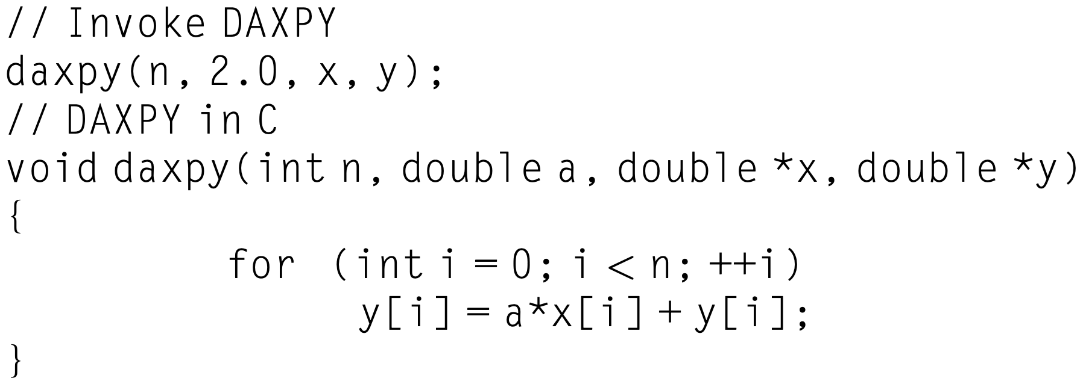
CUDA Program
DAXPY in C:

Slide 94
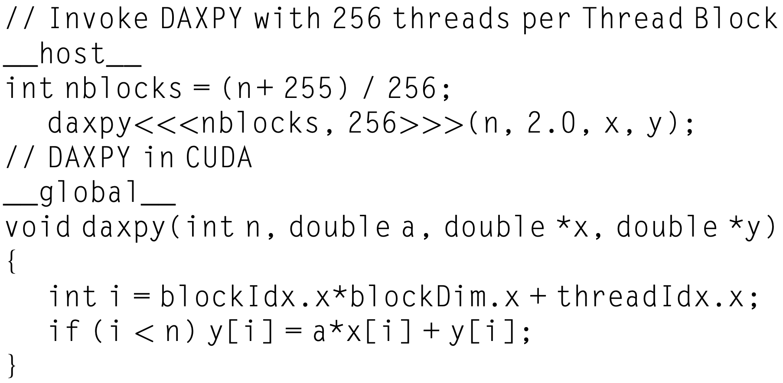
CUDA Program
DAXPY in CUDA:

Slide 95
CUDA Program
GPU hardware handles parallel execution and
thread management
DAXPY in CUDA:

Slide 96
CUDA Program
thread blocks execute independently, in any order
they cannot communicate directly
DAXPY in CUDA:

Slide 97
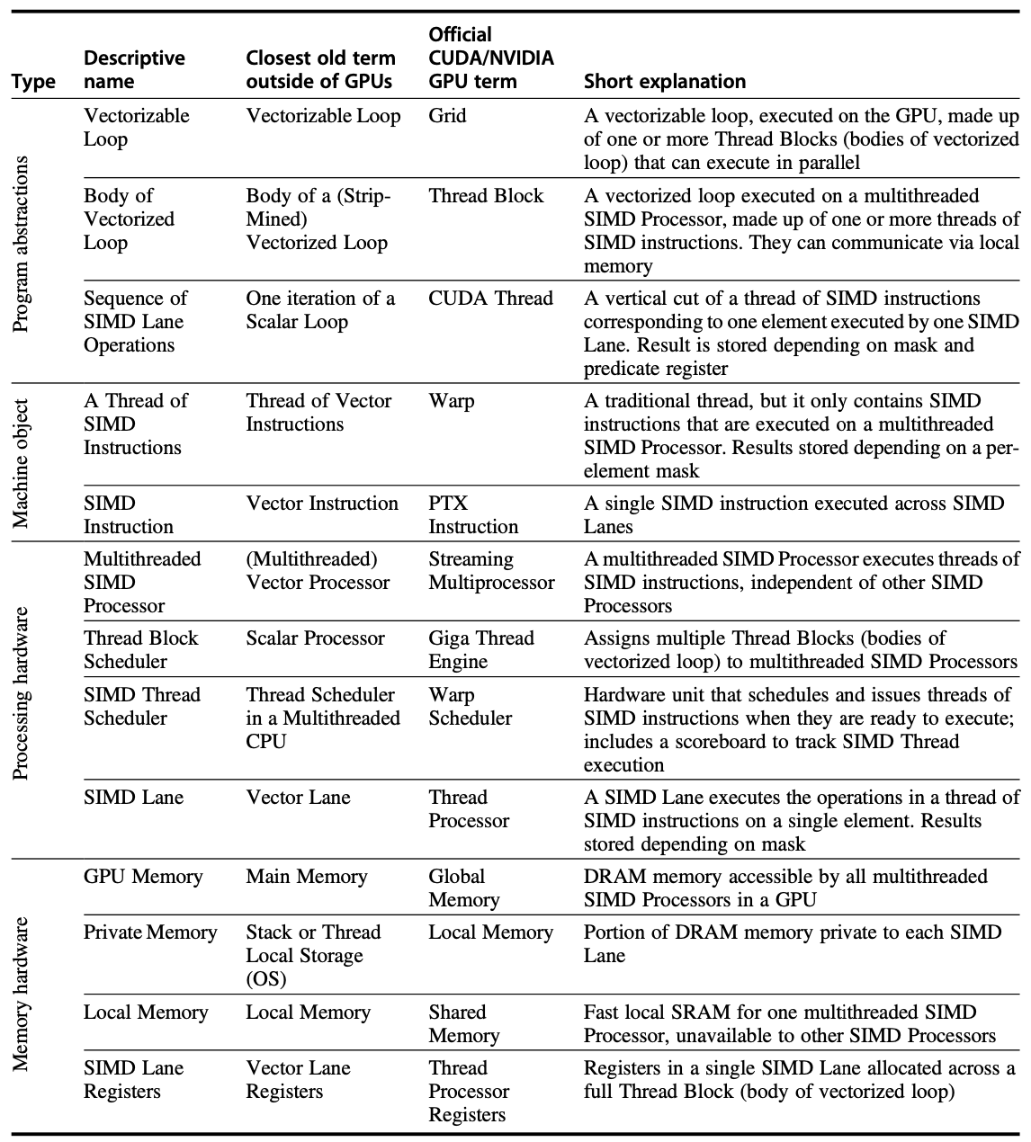
CUDA Program
Micro- architectural Features
Notes:
From left to right, Figure 4.12 lists the descriptive term used in this section, the closest term from mainstream computing, the official NVIDIA GPU jargon in case you are interested, and then a short explanation of the term. The rest of this section explains the microarchitectural features of GPUs using the descriptive terms on the left in the figure.

Slide 98
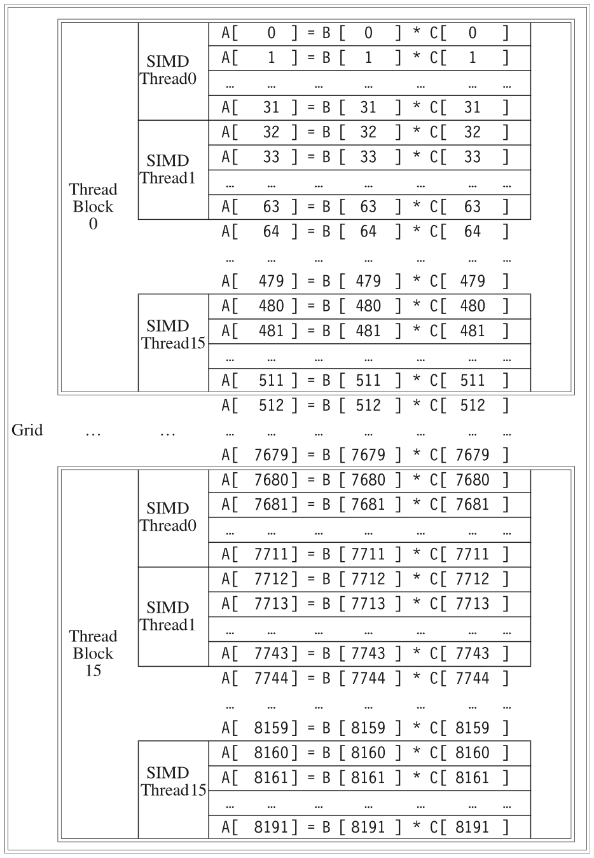
Grid Thread Blocks Threads
Example:
vector multiply
8192 elements
A = B x C
32 elements/thread;
16 threads/block;
16 blocks;
Notes:
Figure 4.13 The mapping of a Grid (vectorizable loop), Thread Blocks (SIMD basic blocks), and threads of SIMD instructions to a vector-vector multiply, with each vector being 8192 elements long. Each thread of SIMD instruc- tions calculates 32 elements per instruction, and in this example, each Thread Block contains 16 threads of SIMD instructions and the Grid contains 16 Thread Blocks. The hardware Thread Block Scheduler assigns Thread Blocks to multithreaded SIMD Processors, and the hardware Thread Scheduler picks which thread of SIMD instructions to run each clock cycle within a SIMD Processor. Only SIMD Threads in the same Thread Block can communicate via local memory. (The maximum number of SIMD Threads that can execute simultaneously per Thread Block is 32 for Pascal GPUs.)
A Grid is the code that runs on a GPU that consists of a set of Thread Blocks. Figure 4.12 draws the analogy between a grid and a vectorized loop and between a Thread Block and the body of that loop (after it has been strip-mined, so that it is a full computation loop). To give a concrete example, let’s suppose we want to mul- tiply two vectors together, each 8192 elements long: A = B * C. We’ll return to this example throughout this section. Figure 4.13 shows the relationship between this example and these first two GPU terms. The GPU code that works on the whole 8192 element multiply is called a Grid (or vectorized loop). To break it down into more manageable sizes, a Grid is composed of Thread Blocks (or body of a vectorized loop), each with up to 512 elements. Note that a SIMD instruction executes 32 elements at a time. With 8192 elements in the vectors, this example thushas16ThreadBlocksbecause161⁄48192& 512.TheGridandThreadBlock are programming abstractions implemented in GPU hardware that help program- mers organize their CUDA code. (The Thread Block is analogous to a strip-mined vector loop with a vector length of 32.)

Slide 99
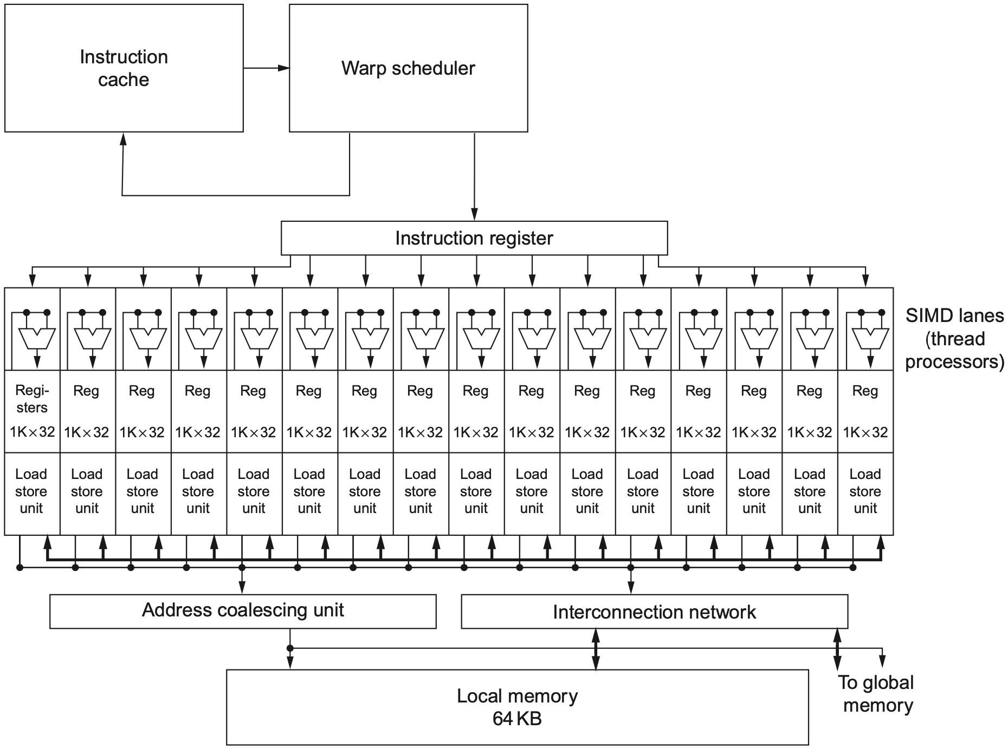
Multithreaded SIMD Processor
16 SIMD Lanes
Notes:
Figure 4.14 Simplified block diagram of a multithreaded SIMD Processor. It has 16 SIMD Lanes. The SIMD Thread Scheduler has, say, 64 independent threads of SIMD instructions that it schedules with a table of 64 program counters (PCs). Note that each lane has 1024 32-bit registers.
A Thread Block is assigned to a processor that executes that code, which we call a multithreaded SIMD Processor, by the Thread Block Scheduler. The programmer tells the Thread Block Scheduler, which is implemented in hardware, how many Thread Blocks to run. In this example, it would send 16 Thread Blocks to multithreaded SIMD Processors to compute all 8192 elements of this loop
Figure 4.14 shows a simplified block diagram of a multithreaded SIMD Processor. It is similar to a vector processor, but it has many parallel functional units instead of a few that are deeply pipelined, as in a vector processor. In the pro- gramming example in Figure 4.13, each multithreaded SIMD Processor is assigned 512 elements of the vectors to work on. SIMD Processors are full processors with separate PCs and are programmed using threads (see Chapter 3).

Slide 100
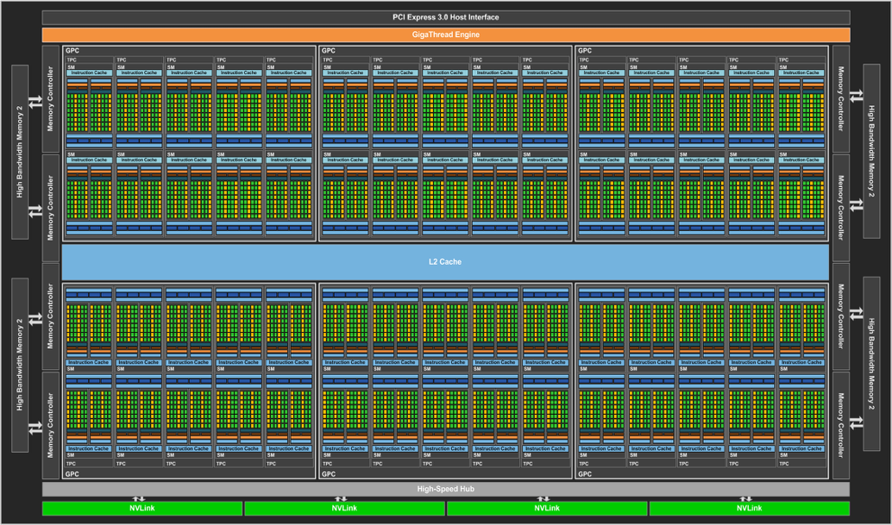
Multithreaded SIMD Processor
Pascal P100 GPU
56 Multithreaded SIMD Processor
16 SIMD Lanes
Notes:
Figure4.15 Full-chipblockdiagramofthePascalP100GPU.Ithas56multithreadedSIMDProcessors,eachwithan L1 cache and local memory, 32 L2 units, and a memory-bus width of 4096 data wires. (It has 60 blocks, with four spares to improve yield.) The P100 has 4 HBM2 ports supporting up to 16 GB of capacity. It contains 15.4 billion transistors.

Slide 101
SIMD Thread Scheduler
Know which threads of SIMD instructions are ready to run
Send them off to a dispatch unit to be run on the multithreaded SIMD Processor

Slide 102
SIMD Thread Scheduler
Two-level GPU hardware schedulers:
Thread Block Scheduler assign thread blocks (bodies of vectorized loops) to multithreaded SIMD Processors;
SIMD Thread Scheduler schedule when threads of SIMD instructions within a SIMD Processor should run

Slide 103
NVIDIA GPU ISA
PTX: Parallel Thread Execution provide a stable instruction set for compilers as well as compatibility across generations of GPUs
PTX instructions translated to an internal form in software and load time on a GPU

Slide 104
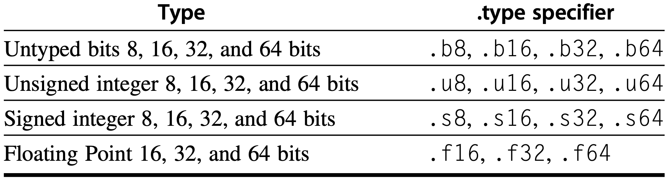
NVIDIA GPU ISA
PTX instruction format: opcode.type d, a, b, c. d: destination operand a, b, c: source operands
Operation types:

Slide 105
NVIDIA GPU ISA
PTX instruction format: opcode.type d, a, b, c. d: destination operand a, b, c: source operands
Source operands: 32-bit / 64-bit registers, constant
Destination operands: registers for non-store instructions, memory addresses for store instructions

Slide 106
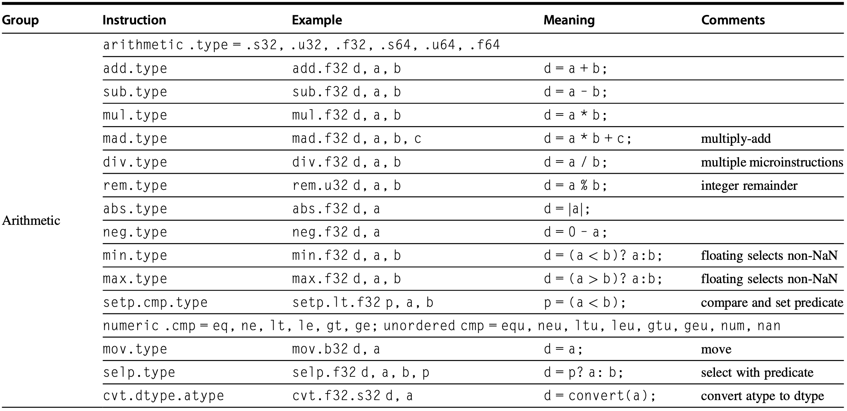
PTX Instructions

Slide 107
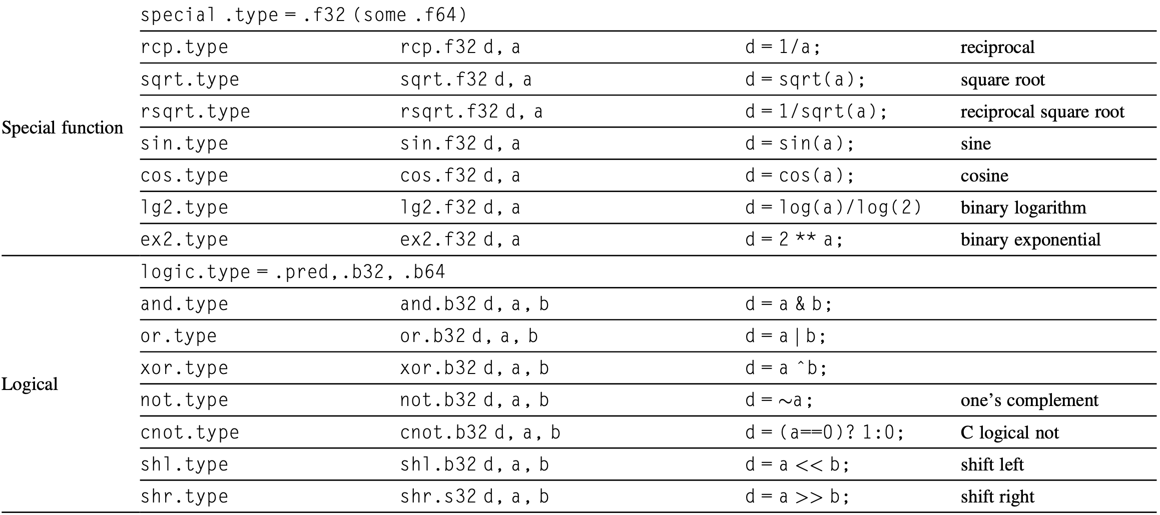
PTX Instructions

Slide 108
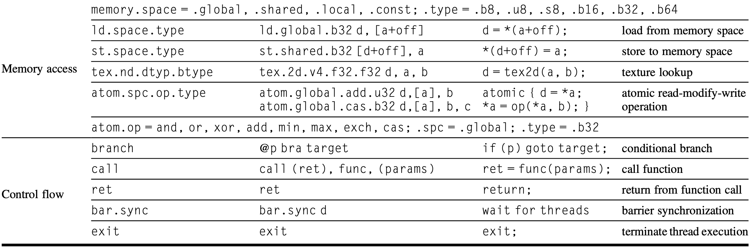
PTX Instructions

Slide 109
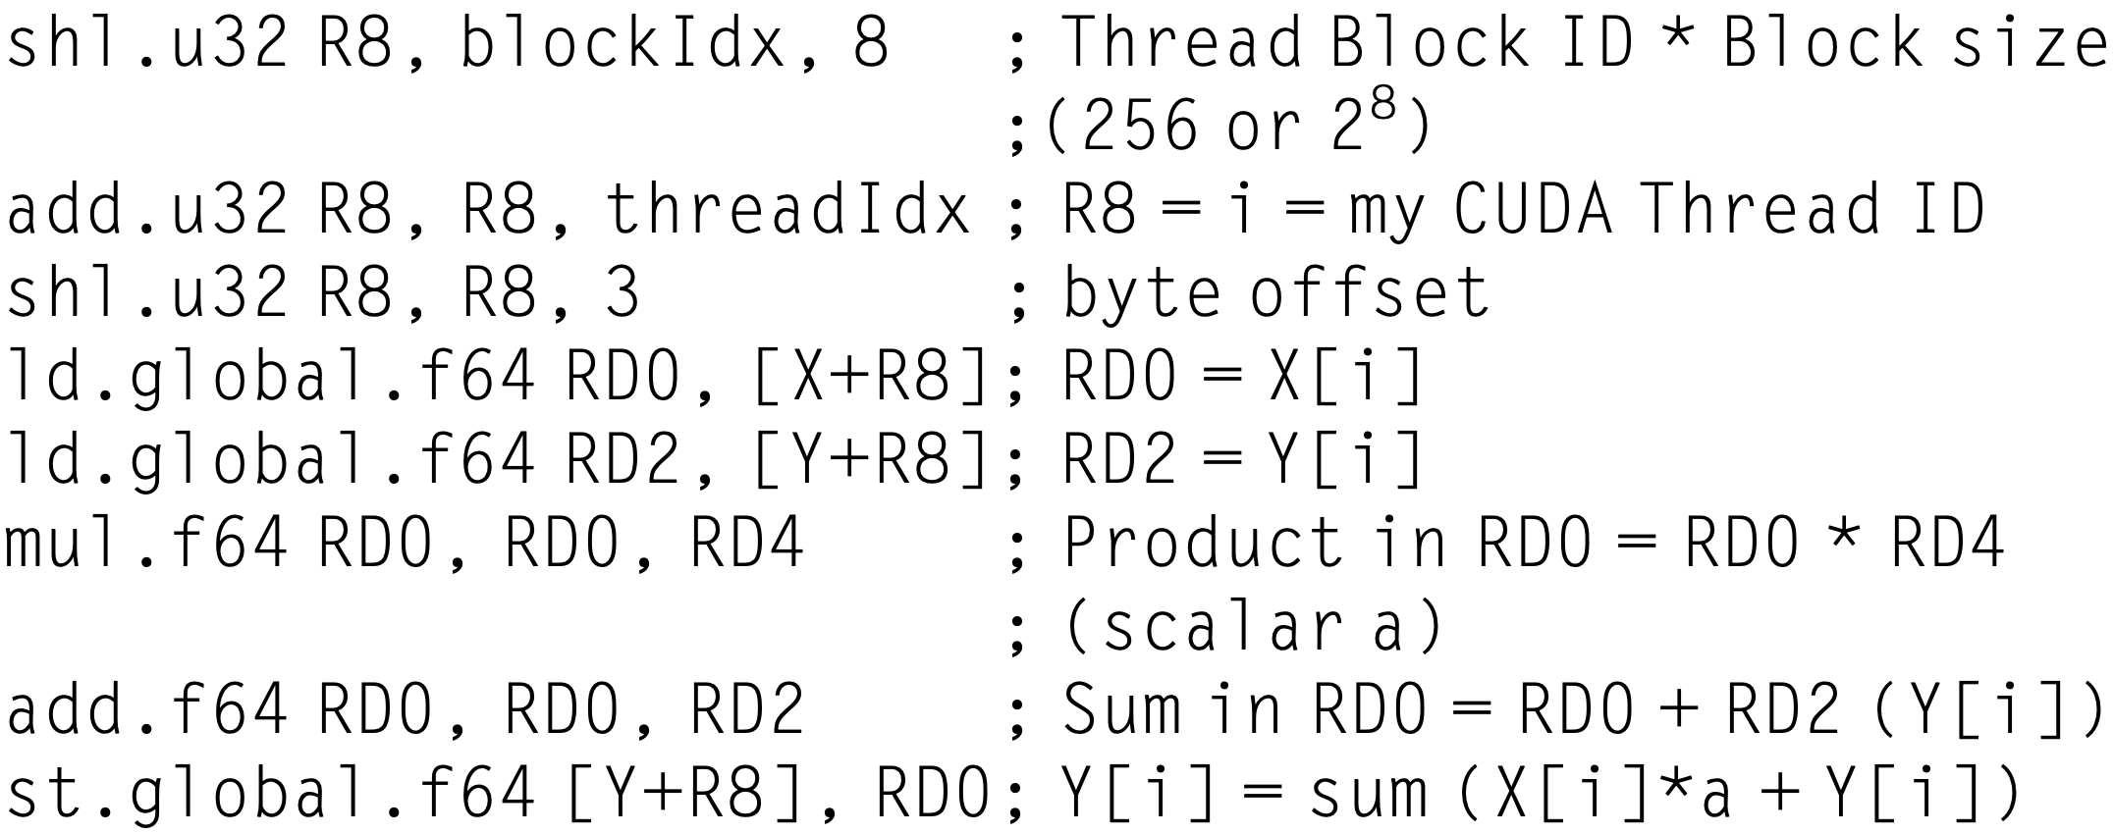
PTX Instructions
DAXPY in PTX:

Slide 110
PTX Instructions
1 thread per element, 256 threads per block,
compute thread index
DAXPY in PTX:

Slide 111
PTX Instructions
each element is 64-bit = 8-byte,
compute address index
DAXPY in PTX:

Slide 112
Conditional Branch
GPU branch hardware predicate registers internal masks branch synchronization stack instruction markers

Slide 113
Predicate Register
Specified by programmer at PTX assembler level
Individual per-thread-lane predication of each instruction
1-bit predicate registers
GPU set predication instruction: setp

Slide 114
Predicate Register
SIMD instructions in the threads inside THEN part of IF statement broadcast operations to all SIMD lanes
Lanes with predicate set to 1 perform an operation or store a result; while other lanes do not
ELSE-instructions use the complement of the predicate

Slide 115
Predicate Register
For equal-length paths, IF-THEN-ELSE operates at 50% efficiency or less
Doubly nested IF statements with equal-length paths run at 25% efficiency

Slide 116
Branch Sync Stack
Each SIMD Thread has its own stack at GPU hardware instruction level
Stack entry: identifier token target instruction address target thread-active mask

Slide 117
Branch Sync Stack
Special instructions that push stack entries for a SIMD Thread
Special instructions and instruction markers that pop a stack entry or unwind the stack to a specified entry and branch to the target instruction address with the target thread-active mask

Slide 118
Conditional Branch
Optimize a simple outer-level IF-THEN-ELSE statement coded with PTX branch instructions to solely predicated GPU instructions

Slide 119
Conditional Branch
Optimize more complex control flow to a mixture of predication and GPU branch instructions with special instructions and markers that use the branch sync stack
Branch diverges when some lanes branch to the target address and push a stack entry
Branch converges when lanes pop stack entry & branch to stack-entry address

Slide 120
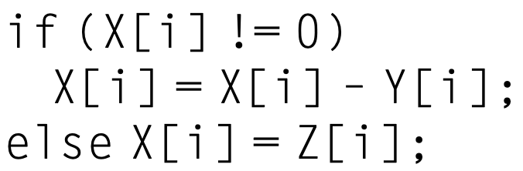
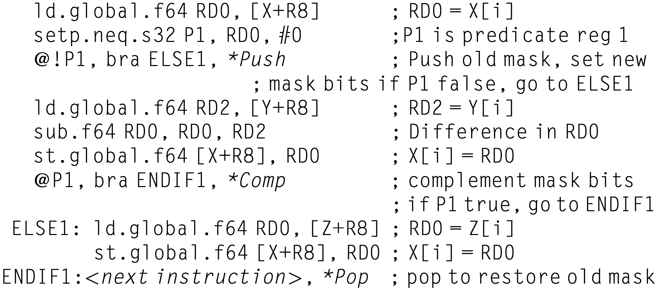
Conditional Branch
Conditional statement
PTX instructions

Slide 121
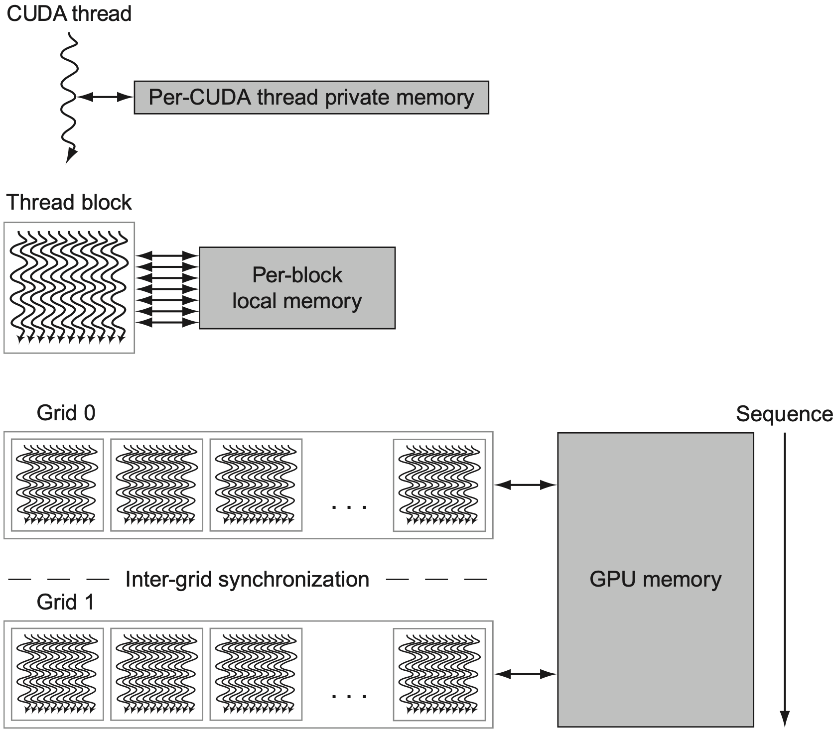
GPU Memory
Notes:
Figure 4.18 GPU memory structures. GPU memory is shared by all Grids (vectorized loops), local memory is shared by all threads of SIMD instructions within a Thread Block (body of a vectorized loop), and private memory is private to a single CUDA Thread. Pascal allows preemption of a Grid, which requires that all local and private memory be able to be saved in and restored from global memory. For completeness sake, the GPU can also access CPU memory via the PCIe bus. This path is commonly used for a final result when its address is in host memory. This option eliminates a final copy from the GPU memory to the host memory.

Slide 122
GPU Memory
shared by co-block threads;
private to other threads and host;
Notes:
Figure 4.18 GPU memory structures. GPU memory is shared by all Grids (vectorized loops), local memory is shared by all threads of SIMD instructions within a Thread Block (body of a vectorized loop), and private memory is private to a single CUDA Thread. Pascal allows preemption of a Grid, which requires that all local and private memory be able to be saved in and restored from global memory. For completeness sake, the GPU can also access CPU memory via the PCIe bus. This path is commonly used for a final result when its address is in host memory. This option eliminates a final copy from the GPU memory to the host memory.

Slide 123
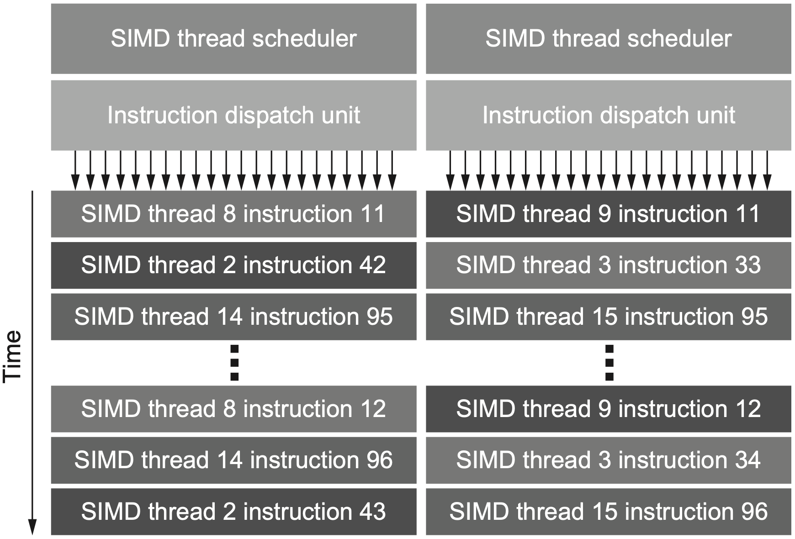
Pascal GPU
Dual SIMD thread scheduler schedules two instructions each clock cycle
Notes:
Figure 4.19 Block diagram of Pascal’s dual SIMD Thread scheduler. Compare this design to the single SIMD Thread design in Figure 4.16.

Slide 124
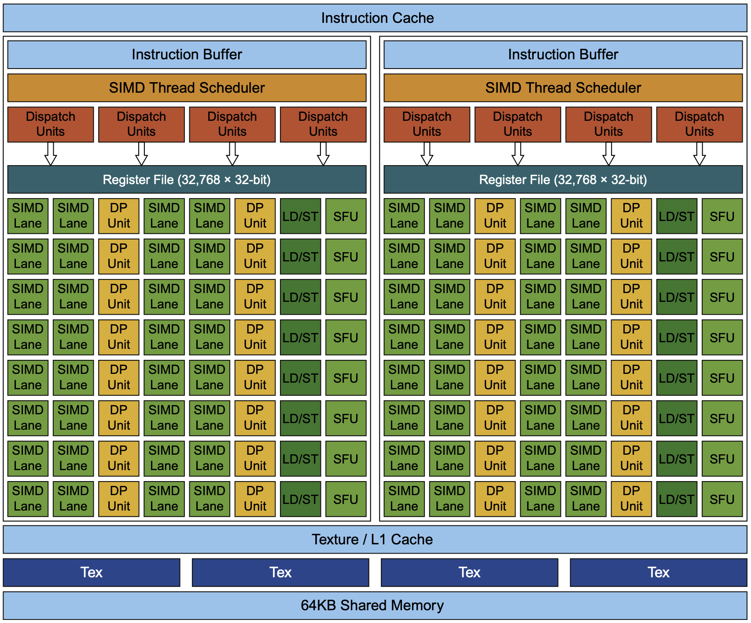
Pascal GPU
Notes:
Figure 4.20 Block diagram of the multithreaded SIMD Processor of a Pascal GPU. Each of the 64 SIMD Lanes (cores) has a pipelined floating-point unit, a pipelined integer unit, some logic for dispatching instructions and oper- ands to these units, and a queue for holding results. The 64 SIMD Lanes interact with 32 double-precision ALUs (DP units) that perform 64-bit floating-point arithmetic, 16 load-store units (LD/STs), and 16 special function units (SFUs) that calculate functions such as square roots, reciprocals, sines, and cosines.
https://versus.com/en/glossary/texture-rate
What is texture rate?
To understand the texture rate of a GPU, it helps first to know how it relates to the graphics card of a device and how they’re both tied to the GPU clock speed. Also known as engine clock, GPU clock speed indicates how fast the cores of a graphics processing unit (GPU) are. The function of these cores is to render graphics; therefore, the higher the GPU clock speed, the faster the processing.
Now, texture rate, also called texture fill rate, refers to the number of textured pixels that a graphics card can render on the screen every second. This means that it refers to the speed at which a graphics card can essentially “fill” the screen with pixels.
To calculate the texture fill rate, you need to know the GPU clock speed and the amount of TMUs, or texture mapping units, that a graphics card has. Generally, you’ll follow the following formula. You always express the texture fill rate as a measurement over time. The measurement is texels, which represent textured picture elements that are processed and shown on the screen.
Core Clock Speed x TMUs = Texture Fill Rate
However, depending on the hardware itself, the actual numbers can vary. In the case of the PNY Quadro RTX 8000, the core clock speed is 1395MHz, and the card has 288 TMUs. But you’ll see that the texture rate is 509.8 GTexels/s.

Slide 125
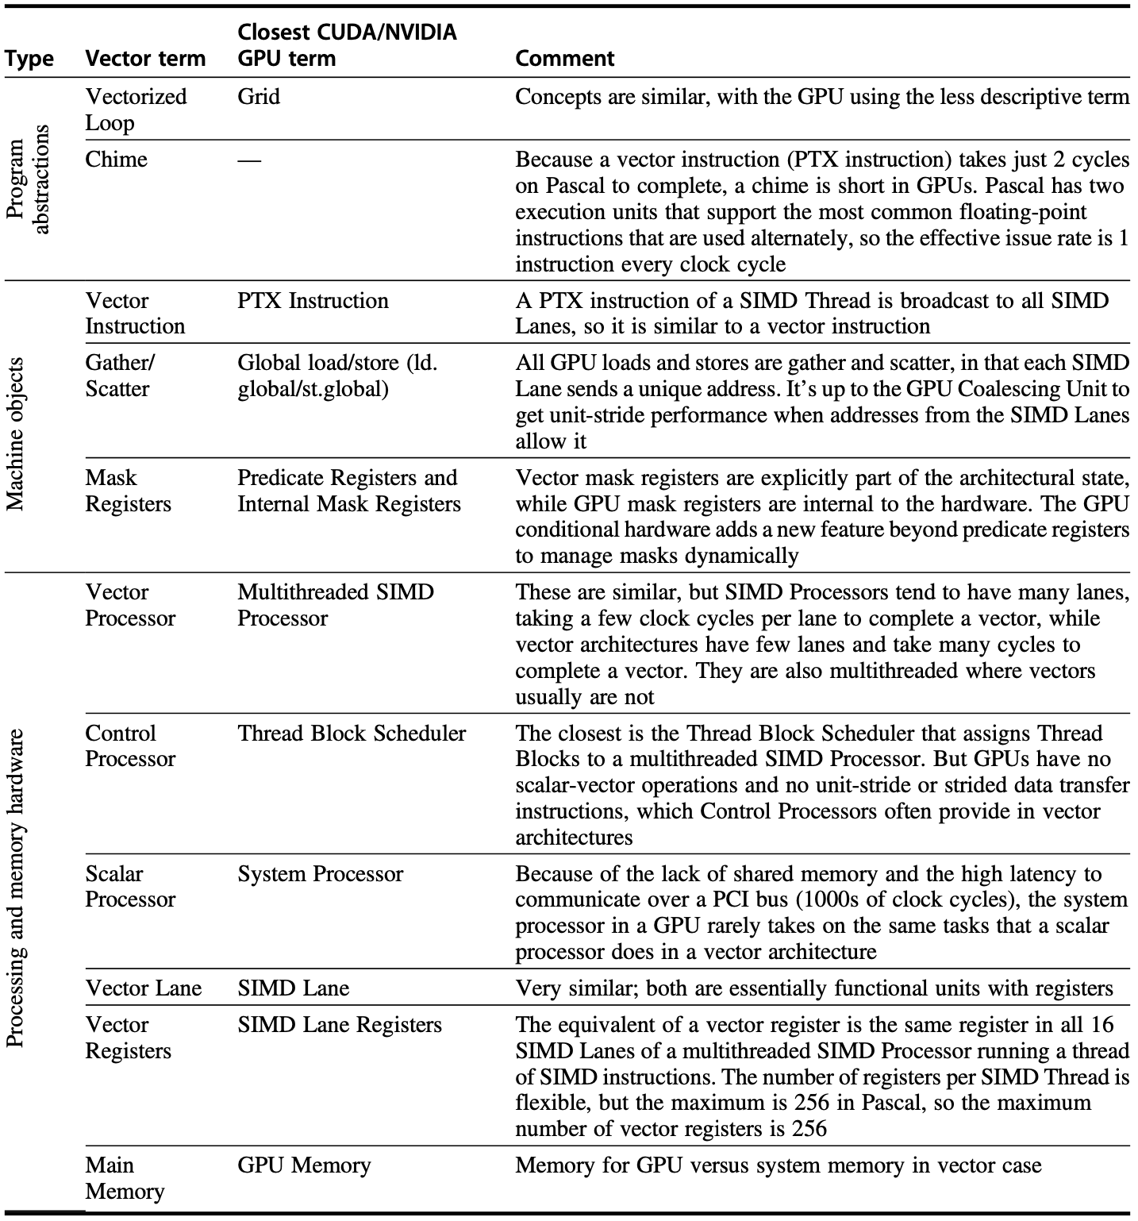
Compare GPU
with
Vector
Notes:
Figure 4.21 GPU equivalent to vector terms.

Slide 126
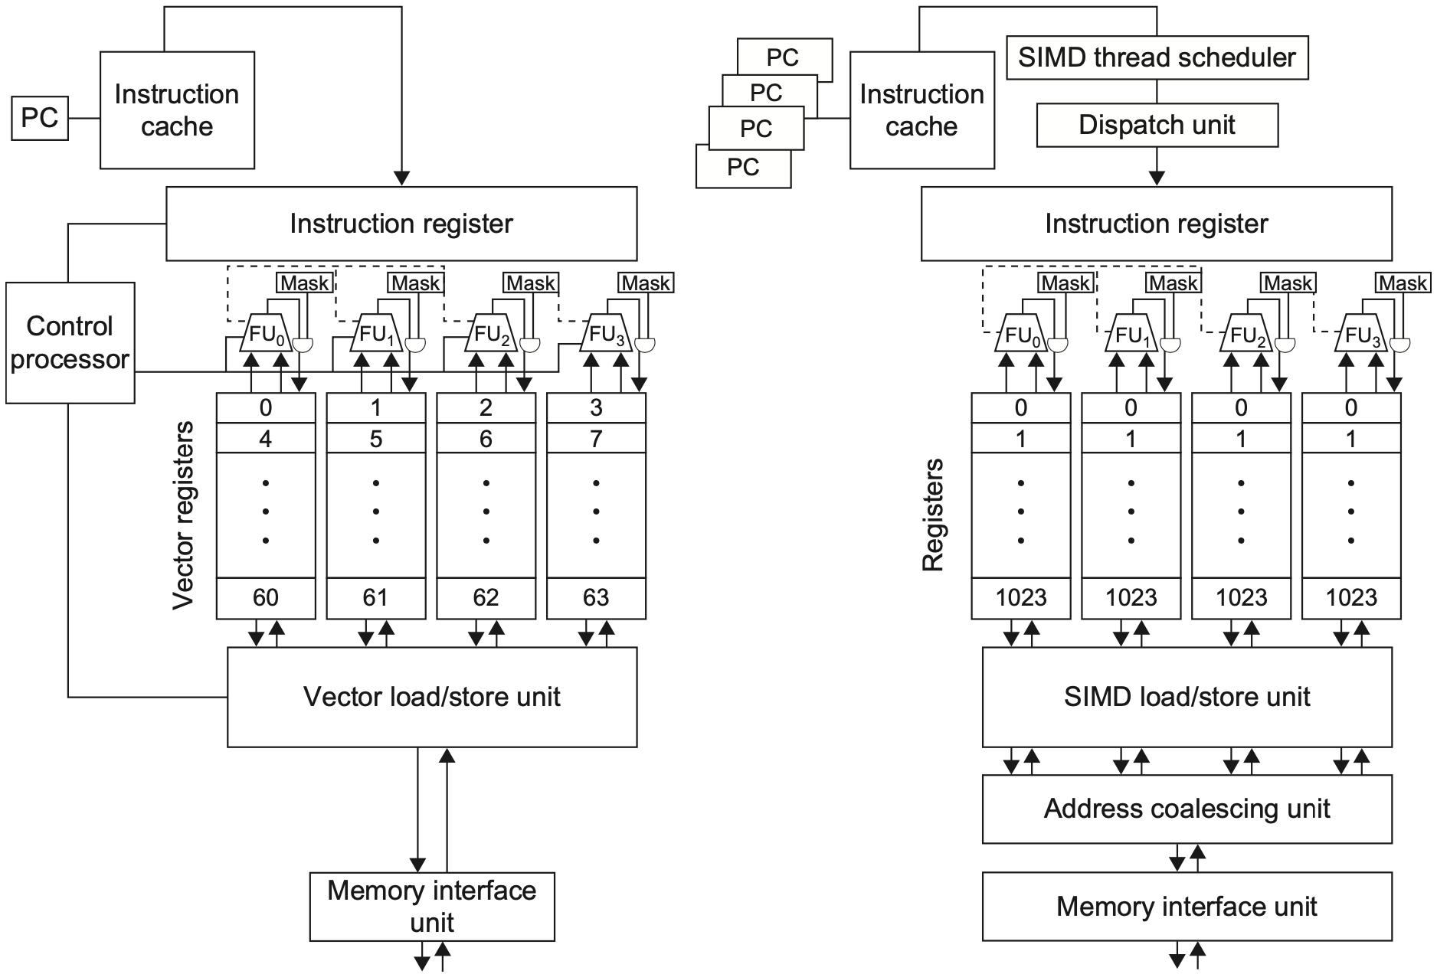
Compare GPU
with
Vector
Notes:
Figure4.22 A vector processor with four lanes on the left and a multithreaded SIMD Processor of a GPU with four SIMD Lanes on the right. (GPUs typically have 16 or 32 SIMD Lanes.) The Control Processor supplies scalar operands for scalar-vector operations, increments addressing for unit and nonunit stride accesses to memory, and performs other accounting-type operations. Peak memory performance occurs only in a GPU when the Address Coalescing Unit can discover localized addressing. Similarly, peak computational performance occurs when all internal mask bits are set identically. Note that the SIMD Processor has one PC per SIMD Thread to help with multithreading.

Slide 127
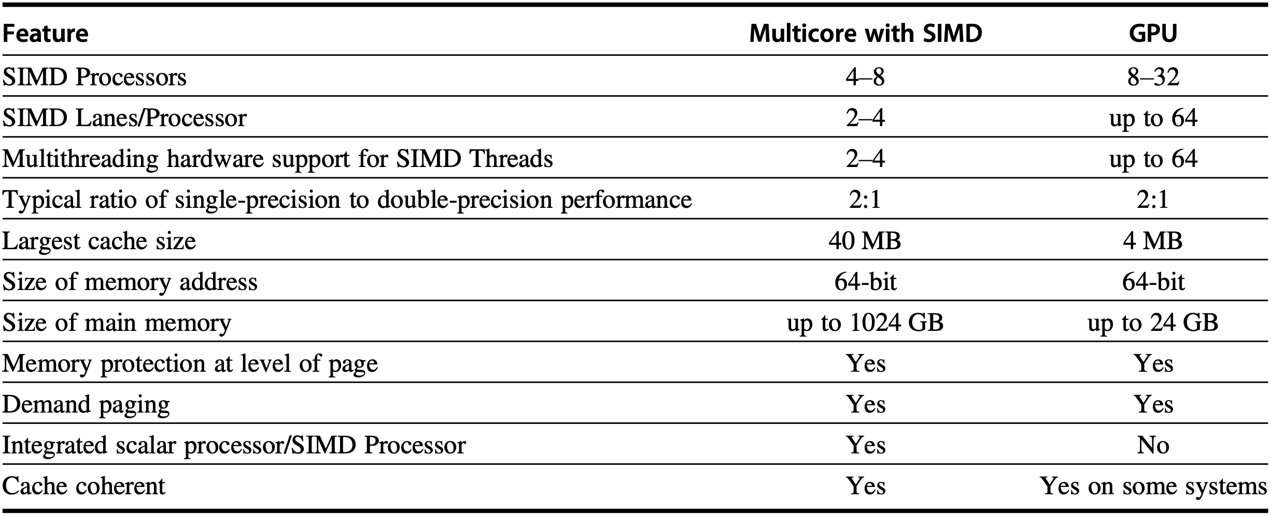
Compare GPU
Multimedia SIMD
with
Vector
Notes:
Figure 4.23 Similarities and differences between multicore with multimedia SIMD extensions and recent GPUs.

Slide 128
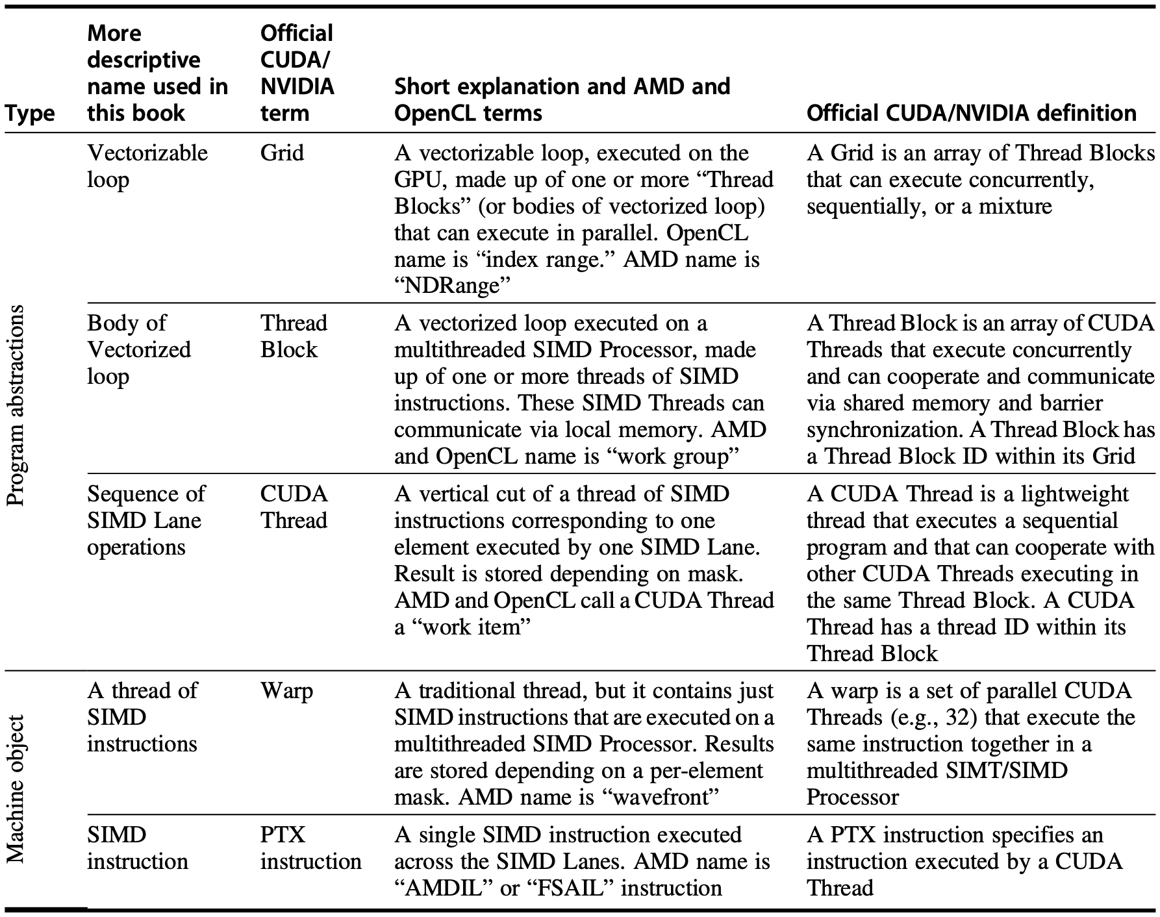
Summary
Notes:
Figure4.24 Conversion from terms used in this chapter to official NVIDIA/CUDA and AMD jargon. OpenCL names are given in the book’s definitions.

Slide 129
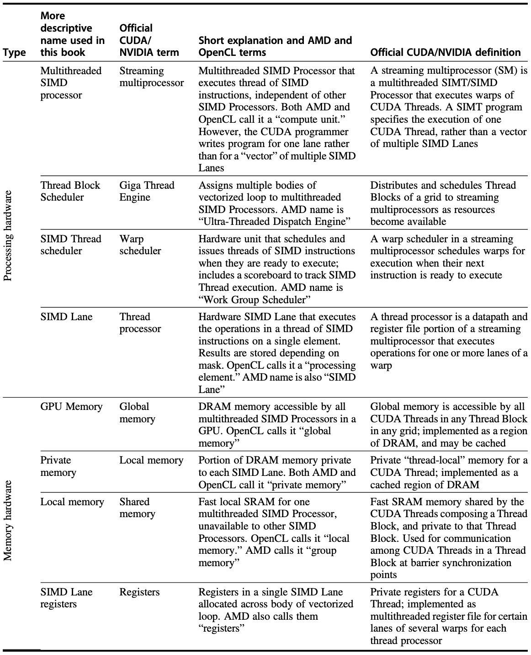
Summary
Notes:
Figure 4.25 Conversion from terms used in this chapter to official NVIDIA/CUDA and AMD jargon. Note that our descriptive terms “local memory” and “private memory” use the OpenCL terminology. NVIDIA uses SIMT (single- instruction multiple-thread) rather than SIMD to describe a streaming multiprocessor. SIMT is preferred over SIMD because the per-thread branching and control flow are unlike any SIMD machine.

Slide 130
Review
Vector Architecture
Multimedia SIMD
GPU

Slide 131
Chapter 4.1-4.4
Notes:
The following content corresponds to chapter 3 (mostly 3.3 – 3.14)
atop the basic working principles of pipelining we have learnt from Appendix C.

Slide 132
Further Reading
GPU Programming by Juan Gómez Luna and Onur Mutlu
Appendix G Vector Processors in More Depth
Appendix H Hardware and Software for VLIW and EPIC

Slide 133
?

Slide 134

Thank You
wherever you go,
there you are.

Slide 135
#What’s More
The Ten Suggestions by Ben Bernanke
The Lesson of Grace in Teaching
by Francis Su

